Slide 1
Depression and Substance Abuse
Low- Income Communities

Slide 2
PROBLEM
Depressive symptoms in youth have become indicators of mental health complications later in life. Studies indicate that being low-income is a risk factor for depression and that socioeconomically disadvantaged youth are more than twice as likely to develop mental illnesses and develop reliance on substance abuse.

Slide 3
Poverty in California
According to official federal poverty statistics, 12.8% of Californians lacked enough resources—about $25,500 per year for a family of four—to meet basic needs in 2018
Nearly one in five (17.6%) Californians were not in poverty but lived fairly close to the poverty line (up to one and a half times above it). All told, more than a third (35.2%) of state residents were poor or near poor in 2018. But the share of Californians in families with less than half the resources needed to meet basic needs was 5.1%, a deep poverty rate that is about the same as official poverty statistics indicate.
Source: https://www.ppic.org/publication/poverty-in-california
Notes:
How does this show that poverty leads to depression and substance abuse?

Slide 4
OBJECTIVES TO ADDRESS THE PROBLEM
To address and educate on the issue of depression and substance abuse within our low-income communities.
To provide resources that improve the livelihood of individuals suffering from depression.
To mitigate and mobilize the stigmas associated with depression and substance abuse.

Slide 5
Our goal is to mobilize and mitigate the 12.8% of Californians lacking resources and decrease poverty rates because we believe that poverty is a big leading factor to causing depression and substance abuse.

Slide 6
Vision
The target population is youth (17-26). We would like to reach as many youth as possible that have suffered depression and substance abuse. In addition, we are targeting youth that come from low-income communities that are suffering with impoverishment, economic instability and lack of information to resources.
We will address this issue by conducting virtual workshops that educate the youth on how to approach life situations in order to avoid feeling lonely, anxious and overwhelmed.
In addition, the virtual workshops are to consider the current COVID-19 pandemic; however, the workshops will be available for in-person interaction once the opportunity is available. Moreover, the virtual workshop program aims to develop other methods that will maintain engagement, enrichment, and excellence in preventing and addressing depression and substance abuse.

Slide 7
How will our vision be implemented?
The vision of the virtual workshops will be implemented through community outreach, cold-calling to youth that desire to be assisted, and conducting surveys to determine the mental, physical and social well-being of the youth.
This goal will be carried out through teamwork, community engagement, and emphasis on the complex ways of maintaining sanity.
The vision will be carried by conducting weekly check-ins with the youth, providing the youth with the necessary information to prevent specific circumstances that might interfere with the progression and development into adulthood
The virtual workshops will implement resources and programs to mandate the youth to take initiative in developing their livelihood, so that their state of wellbeing - mentally, physically, and socially - is enhanced and uplifted.

Slide 8
Prevention
Primary: Parents, Teachers. Role models, Guardians, Peer to Peer
Entails family/role model based prevention programs that strengthen family bonding
Parenting skills
Practice in developing and enforcing family policies on substance abuse
Enhance parent-child communication
Increasing parental involvement
Secondary: School programs
Prevention programs can intervene as early as early as preschool and throughout middle and high school to mitigate risk factors for drug abuse
Aggressive behavior,
poor social skills
academic difficulty
Lack of self-control
Tertiary: Community Programs
Prevention programs that targets general populations at key transition points can yield benefits among high-risk families
Should reach populations in multiple settings such as:
Schools
Clubs, faith-based organizations
Media
Prevention Principles | National Institute on Drug Abuse (NIDA)

Slide 9
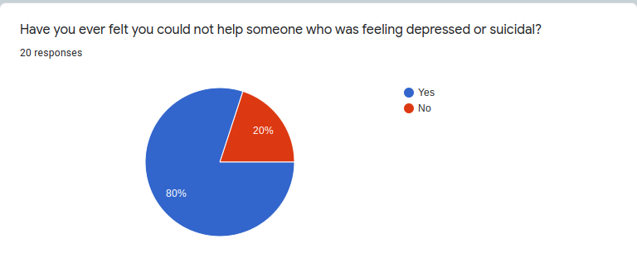
Data

Slide 10
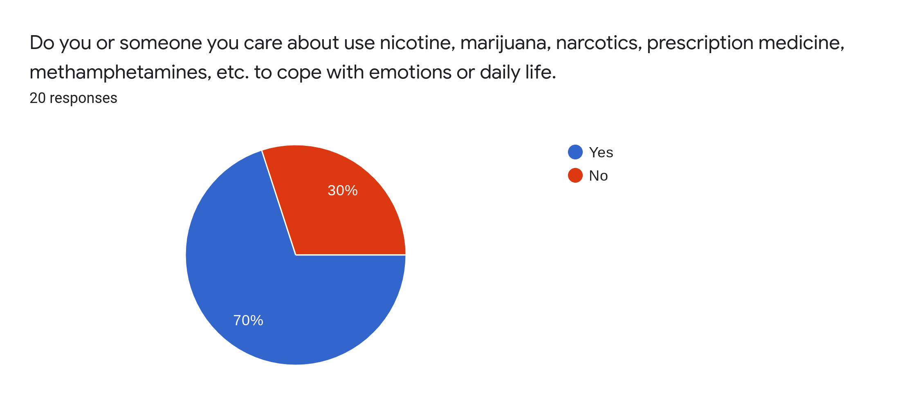
Data

Slide 11
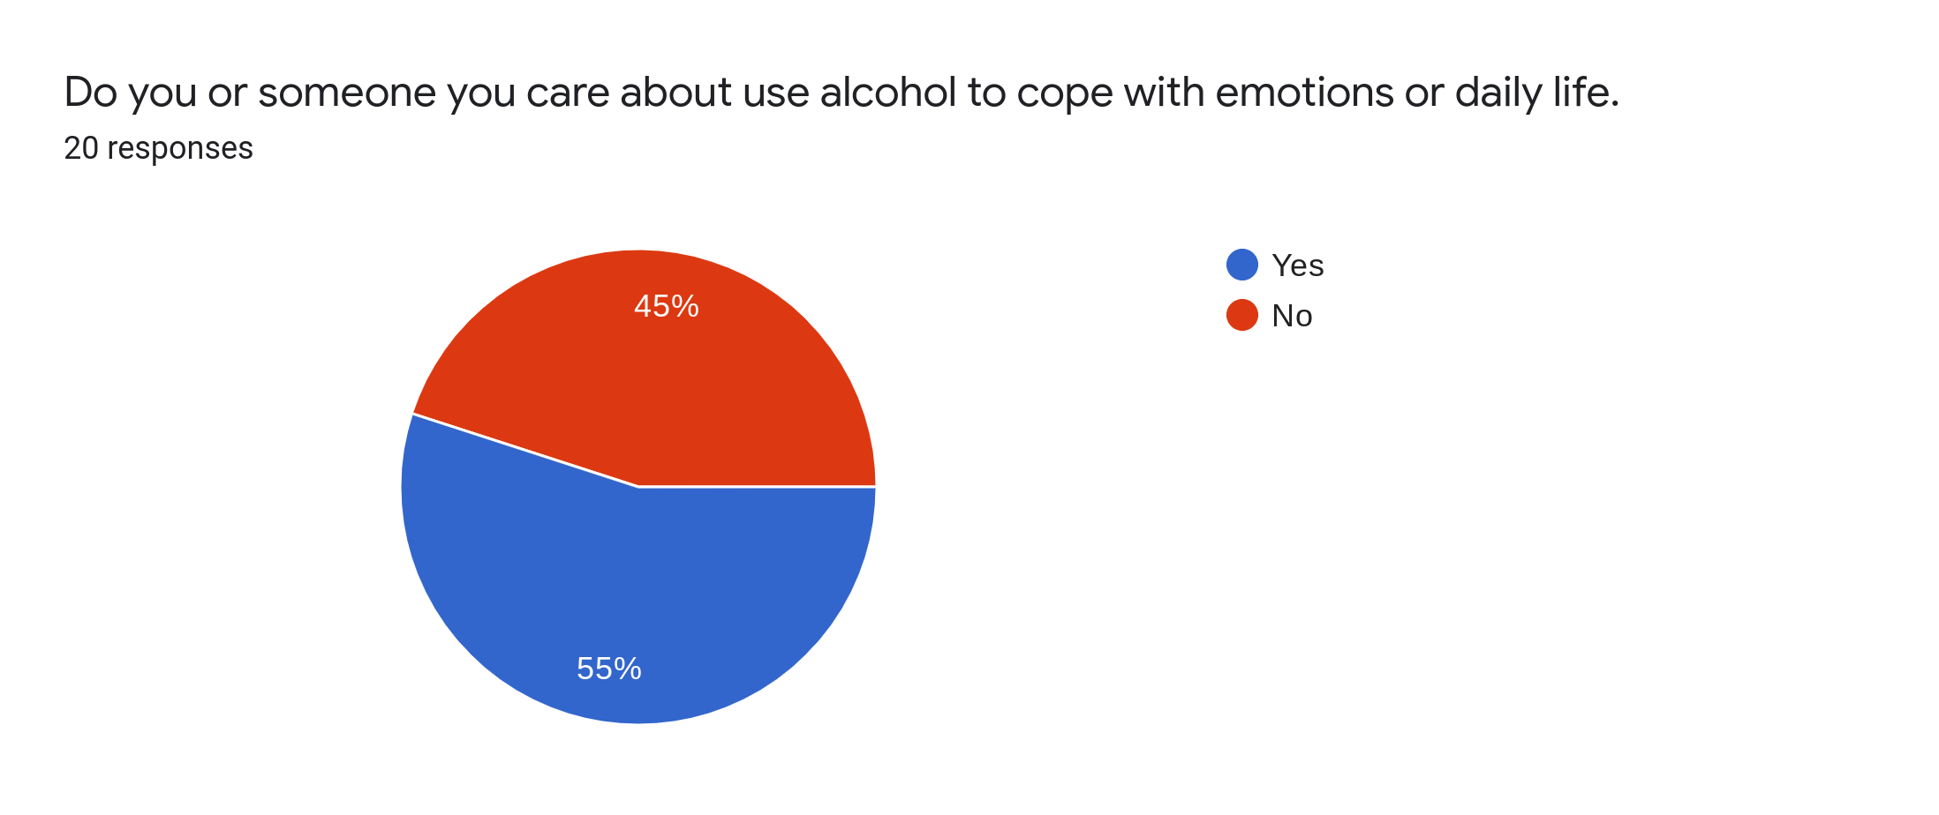
Data

Slide 12
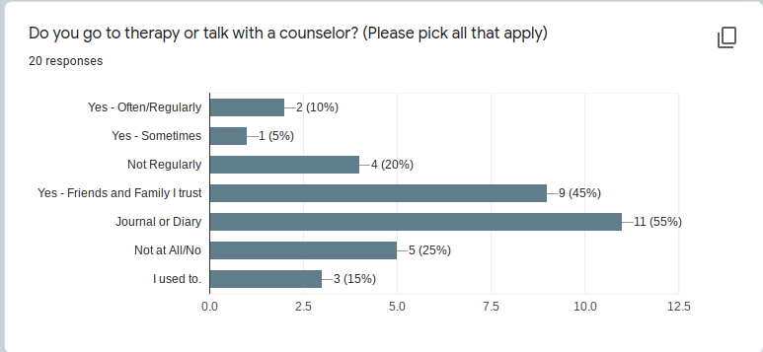
Data

Slide 13
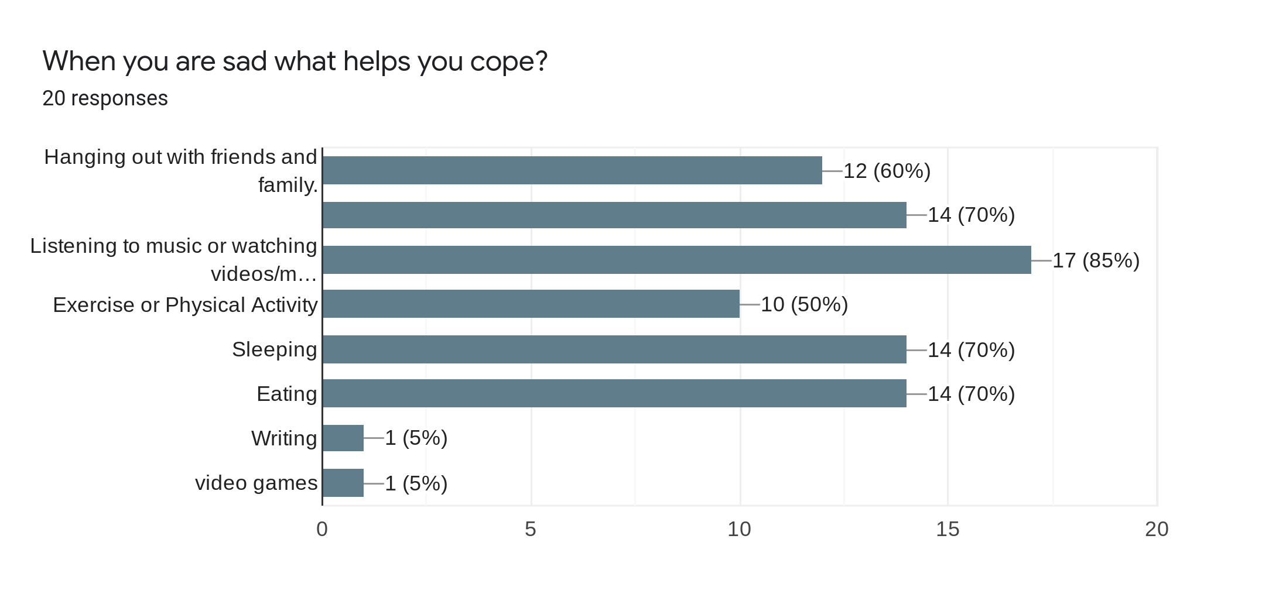
Data

Slide 14
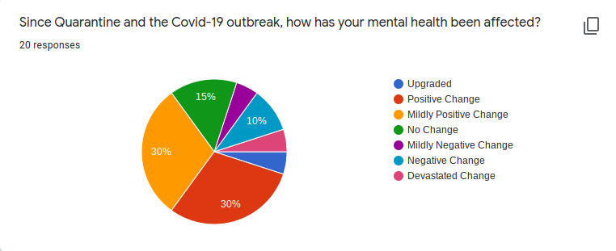
Data

Slide 15
Community Resources
Turning Point Community Programs. www.tpcp.org
Crestwood Behavior. https://crestwoodbehavioralhealth.com
NAMI (National Alliance on Mental Illness) - https://www.nami.org/Home
NIMH (National Institute of Mental Health) - https://www.nimh.nih.gov/index.shtml

