Slide 1

Welcome to the
6th Invest Health
Breakfast
October 31, 2025
Notes:
Thanking for attention, attendance, excitement
Ideas that emerged from strategic planning, not resident input
Peggy

Slide 2

Bonnie Gore
Placer County Board of Supervisors,
District 1
Health Happens Together
Health Happens Together
Notes:
Add word cloud (cleaned up)
Acknowledge Samar
Peggy

Slide 3



Thank You to our Sponsors
Photography by Julie Hansen
Health Happens Together
Health Happens Together
Notes:
Add word cloud (cleaned up)
Acknowledge Samar
Peggy

Slide 4
Debra Oto-Kent
Founder, Executive Director, Health Education Council
Health Happens Together
Health Happens Together
Notes:
Add word cloud (cleaned up)
Acknowledge Samar
Peggy

Slide 5
6th Invest Health
Breakfast
Sierra View Country Club
Debra S. Oto-Kent
October 31, 2025
Notes:
Thanking for attention, attendance, excitement
Ideas that emerged from strategic planning, not resident input
Peggy

Slide 6
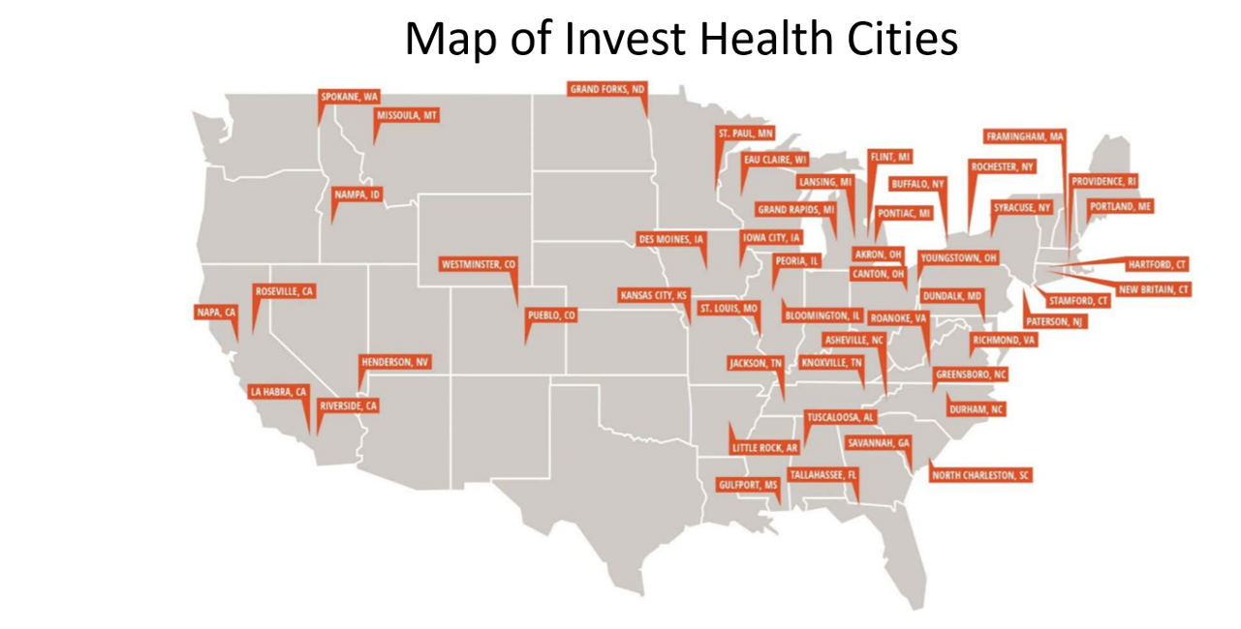


Health Happens Together

Slide 7
Invest Health 1.0 – 3.0 Timeline
182
Cities
Cities submit LOI
2015
102
Cities
50 Cities Selected
Invest Health 1.0
2016 – 2018
120
Cities
10 Cities Awarded
Invest Health Collaboration
2019
20
Cities
10 Cities Awarded
Invest Health 2.0
2022 – 2023
14
Cities
10 Cities Awarded
Invest Health 3.0
2023 – 2024
26 Cities
10 Cities Awarded
Data Health Challenge
2024 – 2025
15 Cities
10 Cities Awarded
Invest Health Collaboration
2024 – 2025
Health Happens Together

Slide 8
Invest Health Timeline
INVEST HEALTH 2.0
10 CITIES
FIELD BUILDING
INVEST HEALTH ADVISORY COMMITTEE
3RD INVEST HEALTH
BREAKFAST
RELATIONSHIP BUILDING
NEIGHBORHOOD IMPROVEMENTS
COLLABORATE WITH
NEIGHBORHOOD ASSOC.
1ST INVEST HEALTH BREAKFAST
ASTHOS FUNDING FOR
RETROSPECTIVE EVALUATION
AND HOW TO TELL OUR
INVEST HEALTH STORY
SACOG EEI INITIATIVE
6TH INVEST HEALTH BREAKFAST
INVEST HEALTH 1.0
50 CITIES
$60,000
INVEST HEALTH 3.0
CITY HEALTH DASHBOARD DATA CHALLENGE INITIATIVE
2016
2017
2018
2019
2020
2021
2022
2023
2024
2025
FORMED CORE TRAVEL TEAM;
RESIDENT ENGAGEMENT
INVEST HEALTH COLLABORATION I
NEVADA & IOWA
2ND INVEST HEALTH BREAKFAST
ROSEVILLE FAMILY
MEAL PROGRAM
COVID SAFETY NET
SUPPORT
INVEST HEALTH COLLABORATION II-
CONNECTICUT
4TH INVEST HEALTH BREAKFAST
INVEST HEALTH COLLABORATION GRANT – SAVANNA, GA; HENDERSON, NV; ROANOKE, VA.
5TH INVEST HEALTH BREAKFAST
Health Happens Together

Slide 9
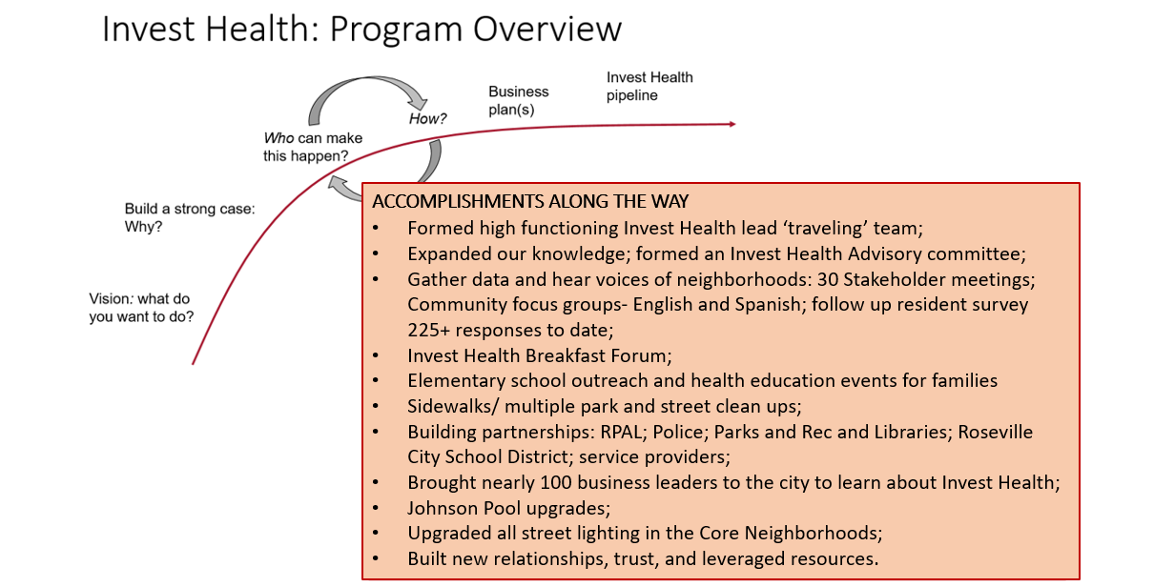
ACCOMPLISHMENTS ALONG THE WAY
Formed high functioning Invest Health lead ‘traveling’ team;
Expanded our knowledge; formed an Invest Health Advisory committee;
Gather data and hear voices of neighborhoods: 30 Stakeholder meetings; Community focus groups- English and Spanish; follow up resident survey 225+ responses to date;
Invest Health Breakfast Forum;
Elementary school outreach and health education events for families
Sidewalks/ multiple park and street clean ups;
Building partnerships: RPAL; Police; Parks and Rec and Libraries; Roseville City School District; service providers;
Brought nearly 100 business leaders to the city to learn about Invest Health;
Johnson Pool upgrades;
Upgraded all street lighting in the Core Neighborhoods;
Built new relationships, trust, and leveraged resources;
Expanded affordable housing builders in Roseville;
City funded reimagining Weber Park.
Health Happens Together

Slide 10
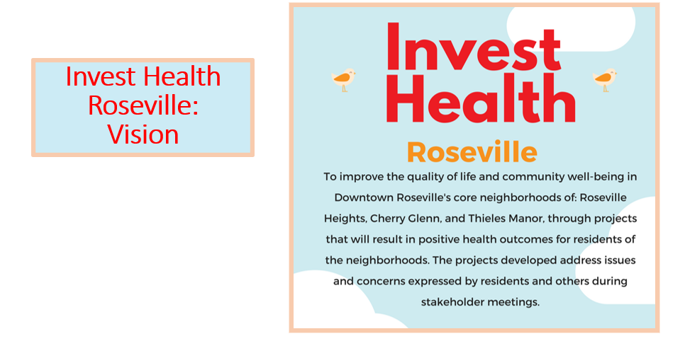
Health Happens Together

Slide 11
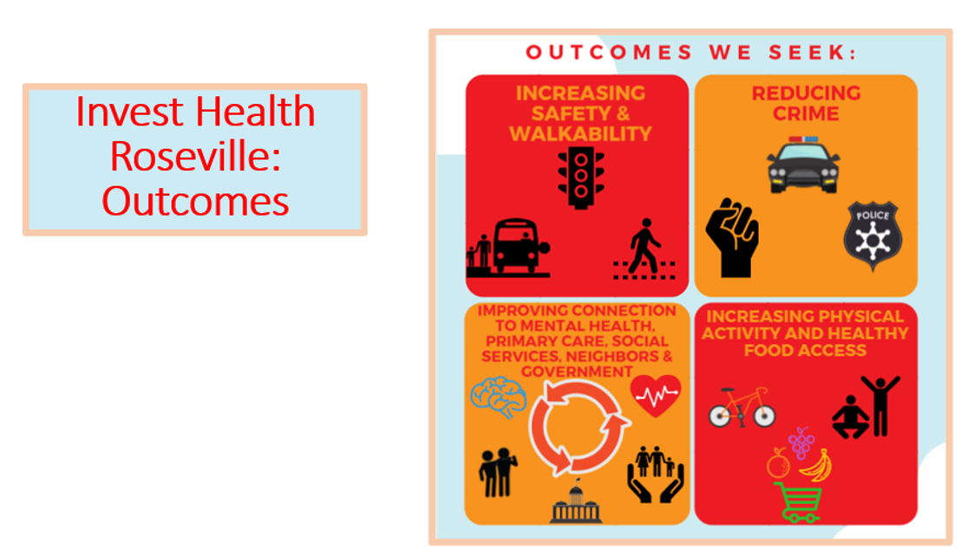
Health Happens Together

Slide 12
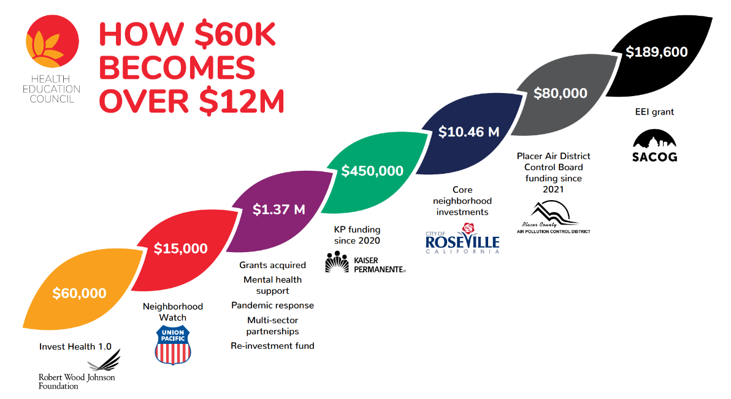

Slide 13
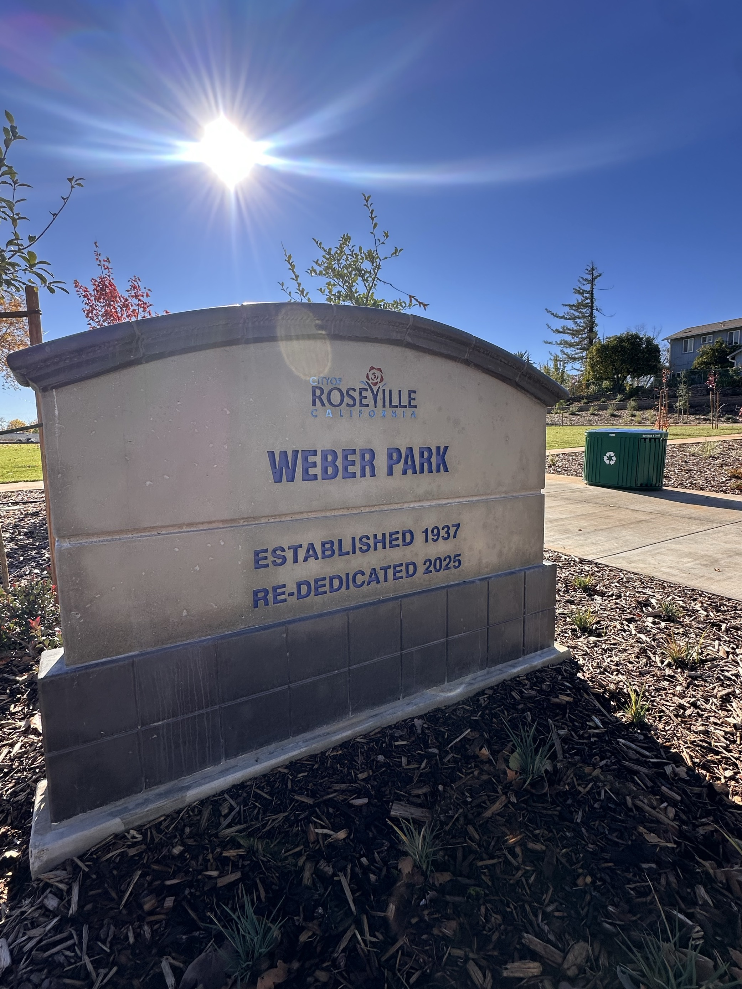
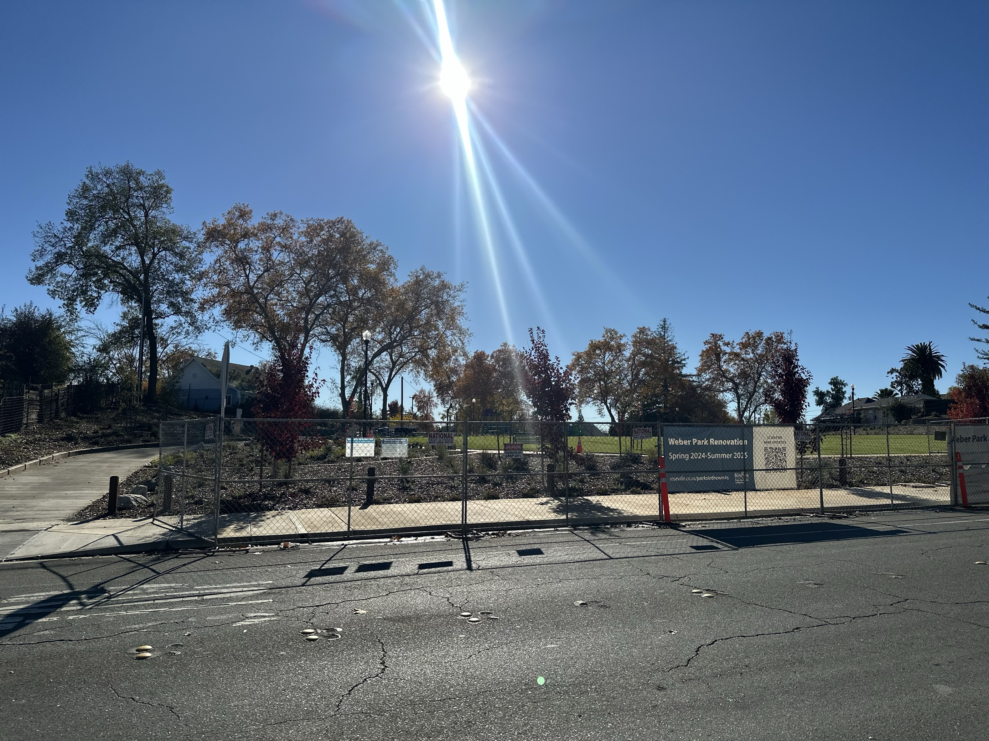
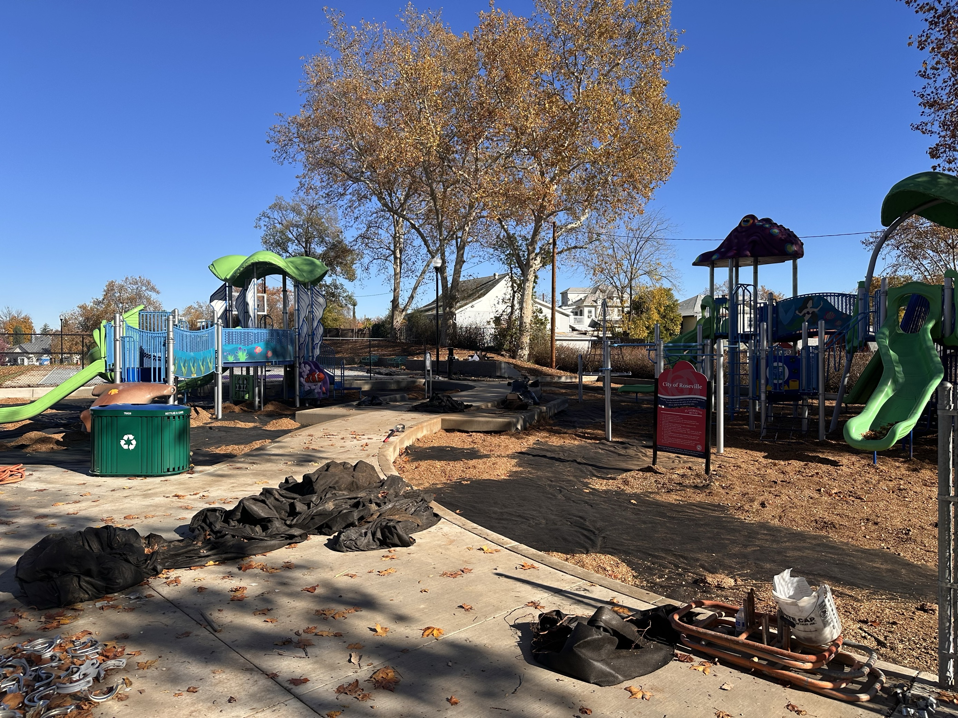
Weber Park Post-script Walkability Impact Story
Health Happens Together

Slide 14
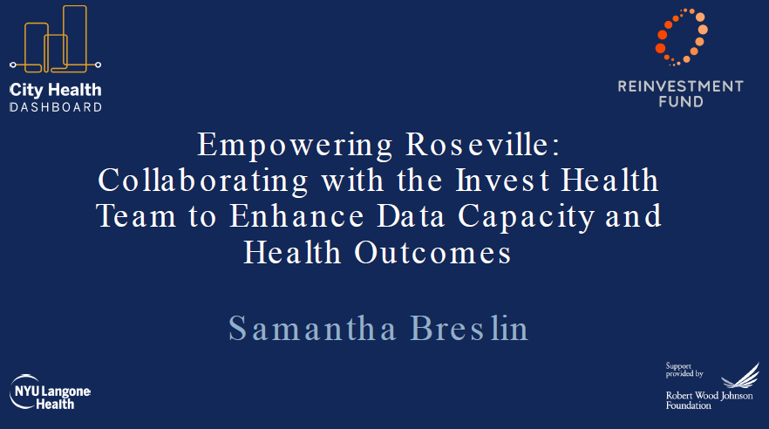
Health Happens Together

Slide 15
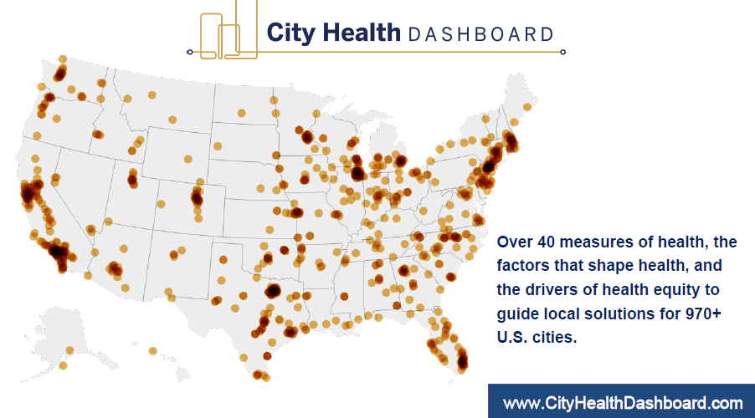

Health Happens Together

Slide 16
Roseville Data Health Challenge
Partners
Jason Buckingham, Executive Director,
Golden Sierra Job Training Agency
Gordon Fowler, Founder, CEO, 3fold Communications
Bonnie Gore, Placer County Supervisor, District 1, Placer County Board of Supervisors
Debra Oto-Kent, Founder, Executive Director, Health Education Council
Gina McColl, Economic Development Analyst II City of Roseville
Megan Scheid, Roseville Deputy City Manager, City of Roseville
Amy Schulz, PhD, MBA, Executive Dean, Workforce and Strategic Initiatives, Sierra College
Involved Sectors
Employment Agencies
Local Government
Elected Officials
Businesses
Nonprofit Organizations
Community College System
Health Happens Together

Slide 17
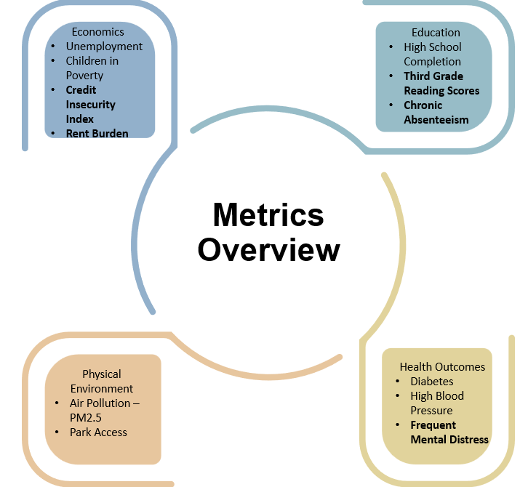
Health Happens Together

Slide 18
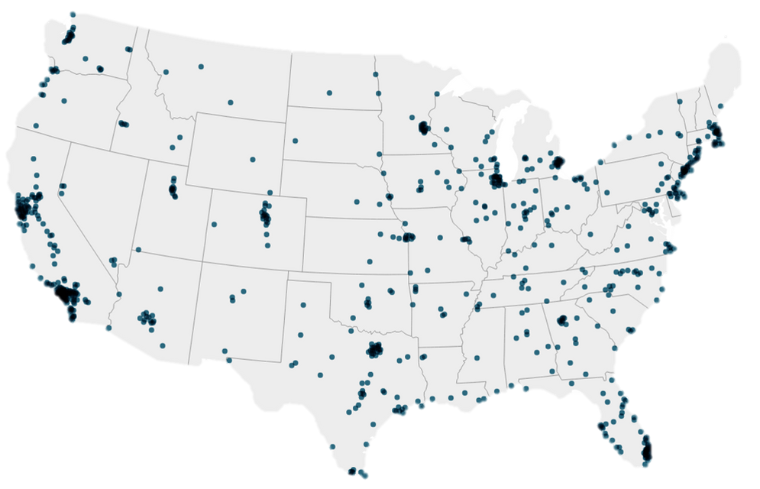

ROSEVILLE, CA
Roseville is doing better than the Dashboard-City Average for 80% of the metrics on the City Health Dashboard
80%
Health Happens Together

Slide 19
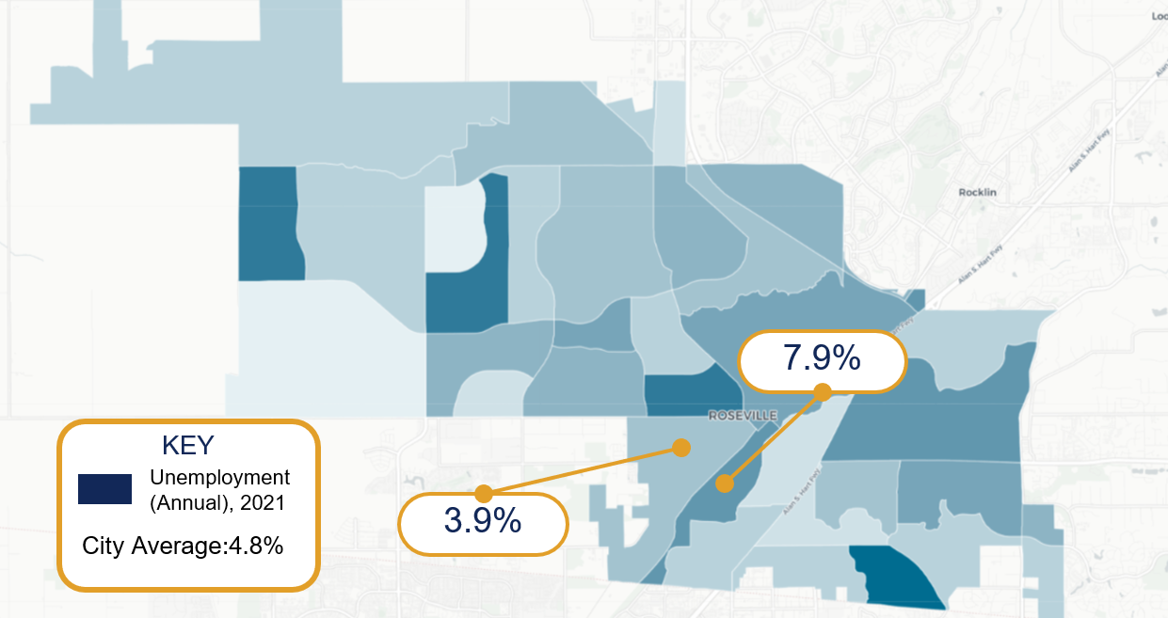
Health Happens Together

Slide 20
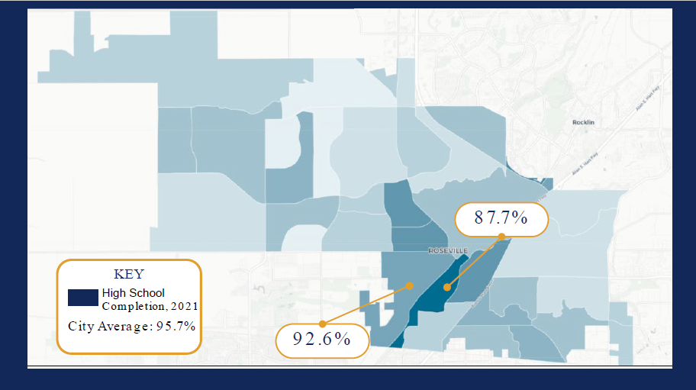
Health Happens Together

Slide 21
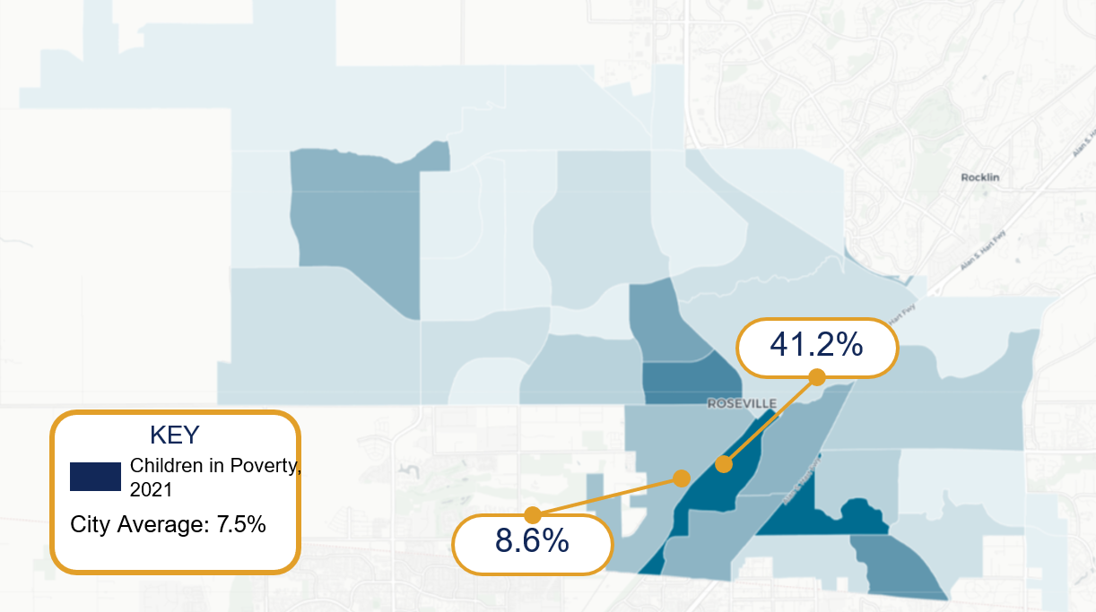
Health Happens Together

Slide 22

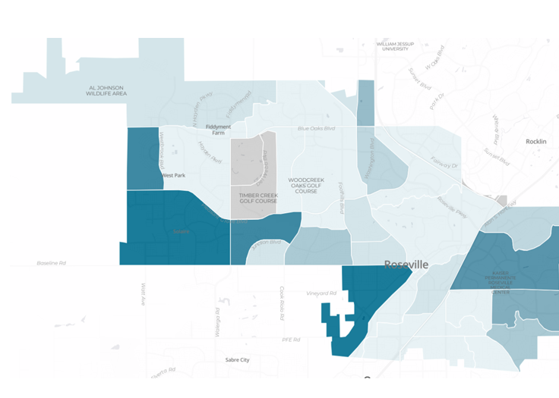

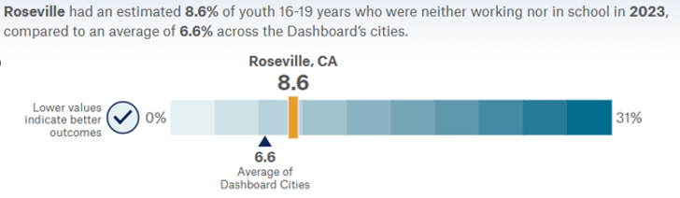
Metric Detail for Youth Not in Work or School in 2023
Percentage of youth 16-19 years who are neither working nor in school, also know as disconnected youth.”
Health Happens Together

Slide 23
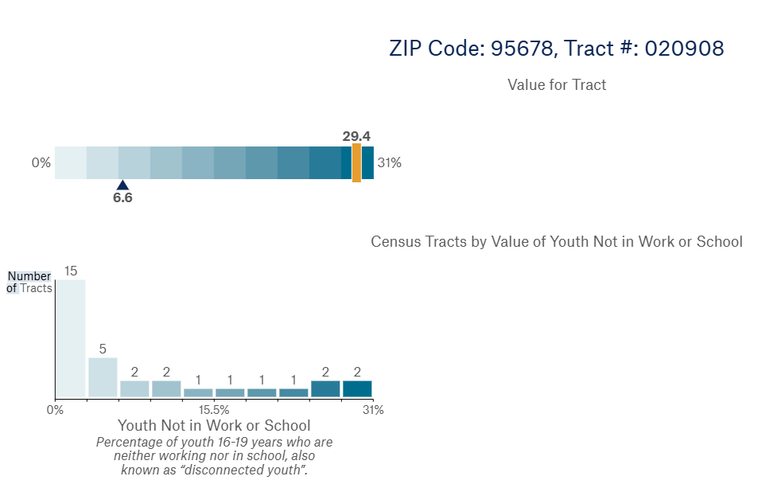
Metric Detail for Youth Not in Work or School in 2023
Percentage of youth 16-19 years who are neither working nor in school, also know as disconnected youth.”
Health Happens Together

Slide 24
Accomplishments
Reviewed data from City Health Dashboard; expanded and adding local data.
Presented initial data set at Invest Health Roseville Stakeholder Breakfast with key stakeholders generating interest.
Reviewed City of Roseville Economic Development Strategic Plan to address where equity metrics can be integrated.
Expanded committee – community college, employment agencies.
Drafting resident engagement plan; meeting with key stakeholders.
Secured SACOG EEI support to expand resident engagement efforts aligned with Data health challenge objectives.
Exploring potential solutions available to align data disparities.
Health Happens Together

Slide 25
Next Steps
Continue to review/ refine data metrics available on City Health Dashboard and add local data for further context.
Implement resident engagement activities to gather insights, direction for action, including engaging existing Invest Health Roseville Stakeholder Advisory group and other resident groups and individuals.
Launch SACOG EEI initiative expand and inform data health challenge analysis to connect Roseville priorities with robust community engagement.
Continue to develop and integrate equity metrics into City plan.
Health Happens Together

Slide 26
Melissa Anguiano
Economic Development Director,
City of Roseville
Health Happens Together
Health Happens Together
Notes:
Add word cloud (cleaned up)
Acknowledge Samar
Peggy

Slide 27
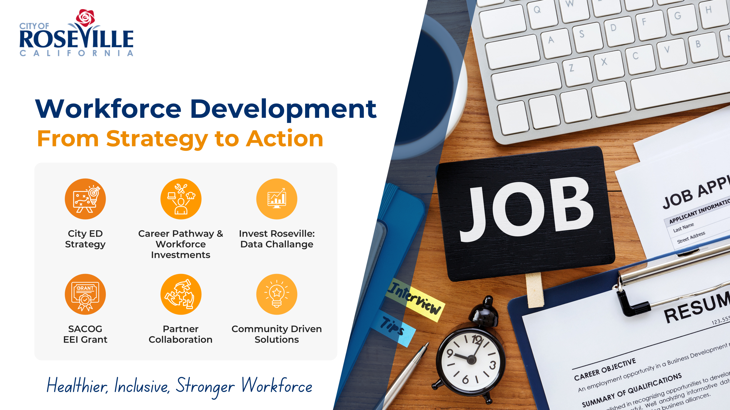

Slide 28
Erica Manuel
CEO & Executive Director,
Institute for Local Government (ILG)
Health Happens Together
Health Happens Together
Notes:
Add word cloud (cleaned up)
Acknowledge Samar
Peggy

Slide 29

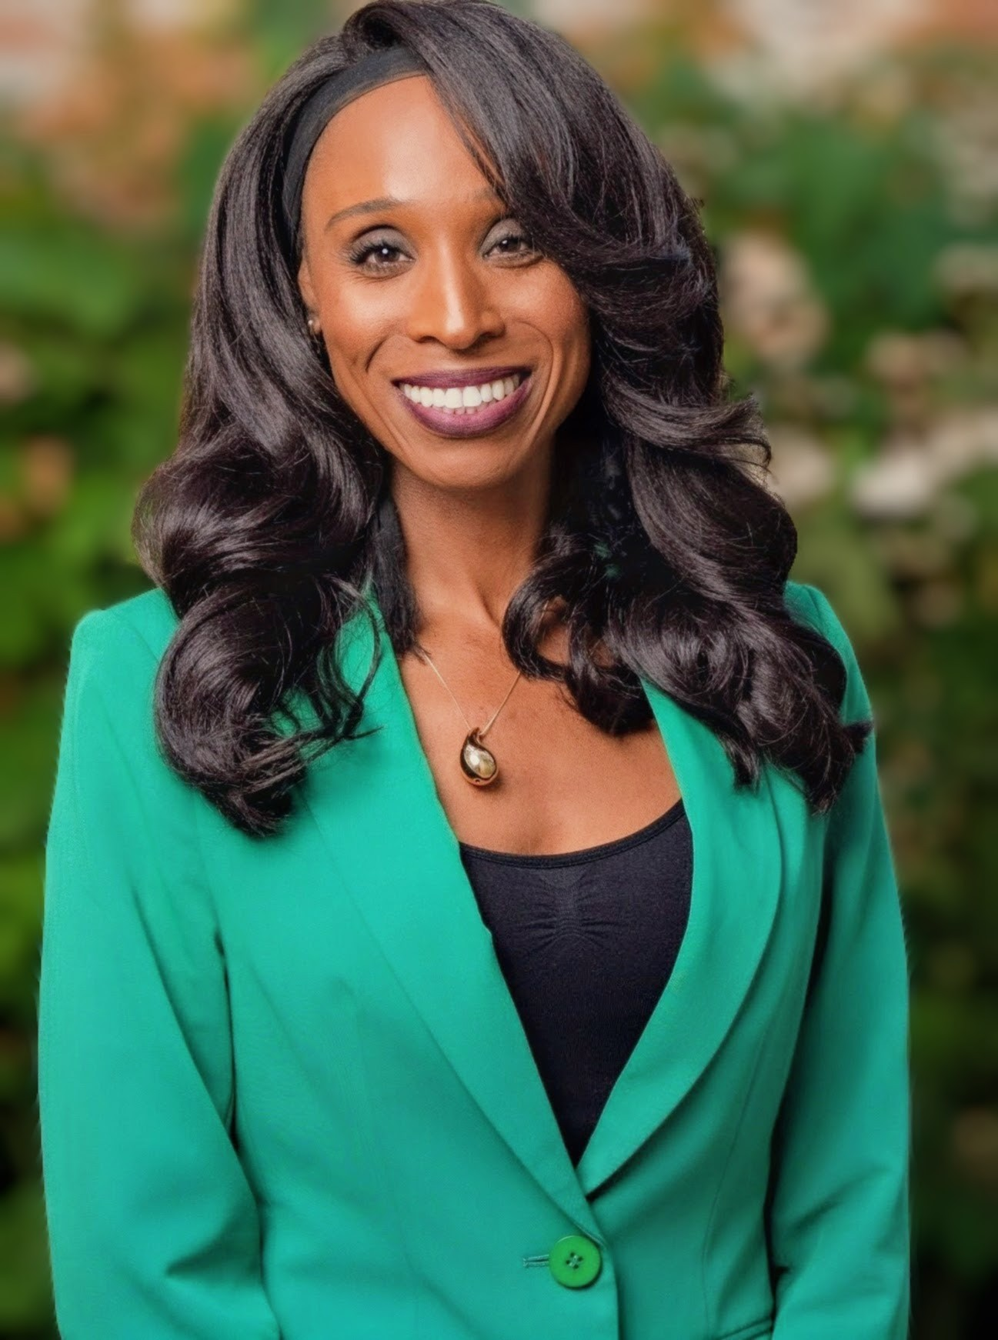
Thank you
for having mE
Erica L. Manuel
CEO & Executive Director

Slide 30

Why Public Sector Workforce Matters
Nearly 1 in 4 jobs in Sacramento are in the
public sector
Critical for
governance, safety,
and services
Sector stability =
community stability

Slide 31
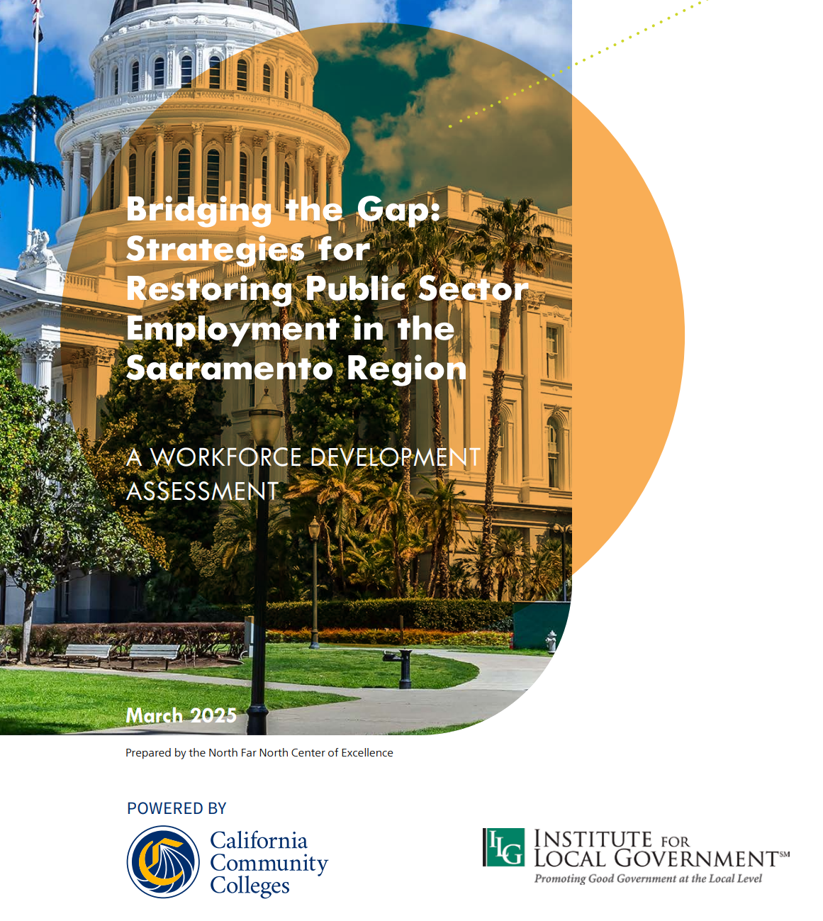
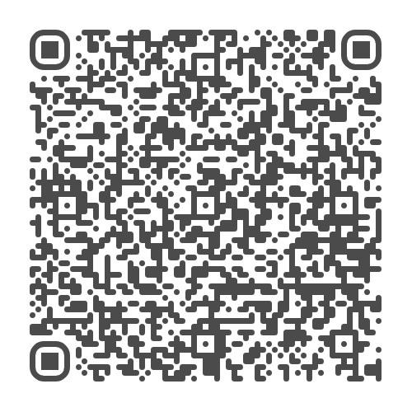
REGIONAL Workforce NEEDS Report
Developed in Partnership with the Centers of Excellence (COE)
Scan here to read the full report:

Slide 32

The reality
Our region faces a critical workforce moment: uncertain budgets, shrinking talent, rising demand, and urgent need for new pathways.

Slide 33
WHAT CAN WE DO?
TRAIN
Invest in hands-on work experience.
PARTNER
SHOWCASE
Make careers in all industries -- including public sector -- visible, modern, and accessible.
CLEAR A PATH
Remove unnecessary barriers.
Meet learners and job-seekers where they are.
ENGAGE
Partner deeply across systems.
1
2
3
4
5

Slide 34

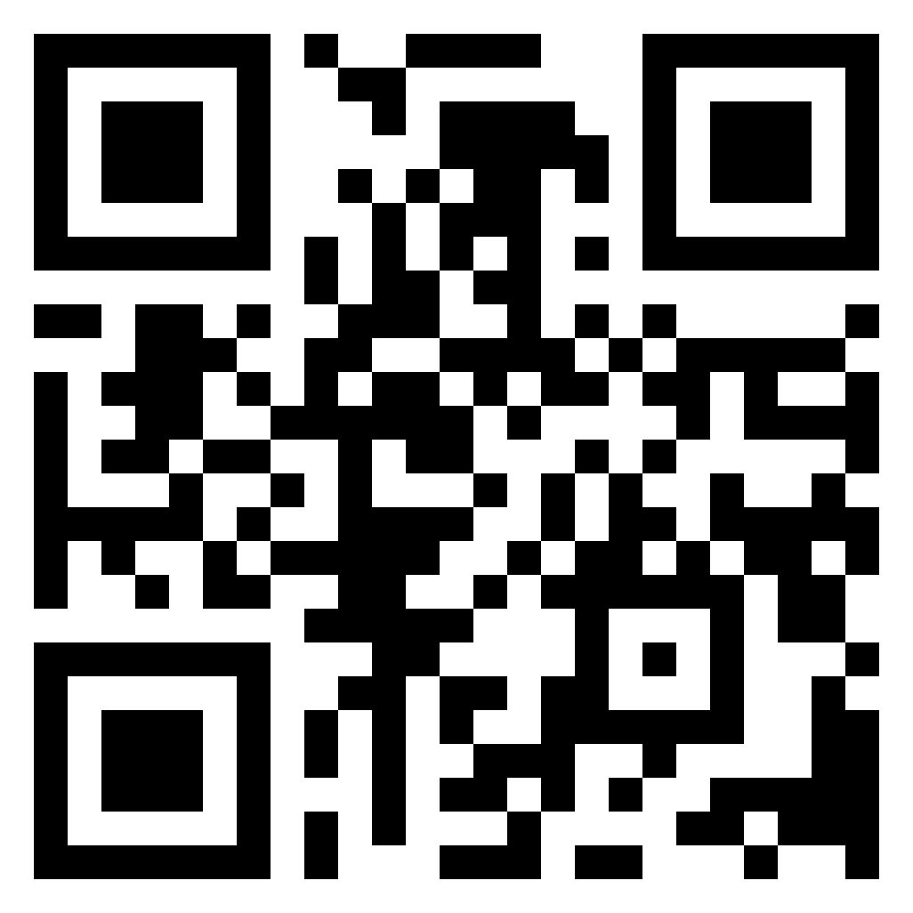
THANK YOU
Erica L. Manuel
CEO & Executive Director
emanuel@ca-ilg.org

Slide 35
Local Workforce Development Panel: Bridging Systems for Workforce Success
    Erica Manuel– Facilitator
    Jason Buckingham
    Elisa Herrera
    Jessica Hull
    Amy Schulz
Health Happens Together

Slide 36
Carol Garcia
Vice President/Community Relations Officer,
River Valley Community Bank
Sierra Joint Community College, Board of Trustees
Health Happens Together
Health Happens Together
Notes:
Add word cloud (cleaned up)
Acknowledge Samar
Peggy

Slide 37
Thank you for joining us!
Health Happens Together
Notes:
Michaella
Resident engagement – will be giving more of an update
Subcommittees – deputy director of impact participating(Amanda Bloom) - would like a few others – summarize training
Resource building – wellness fund, braiding resources, joint funding to implement towards ACH goals, subcommittee, county will be part of that, would like others who would like to play a role in how it's done, how we bring resources into the fund and use them

