Slide 1
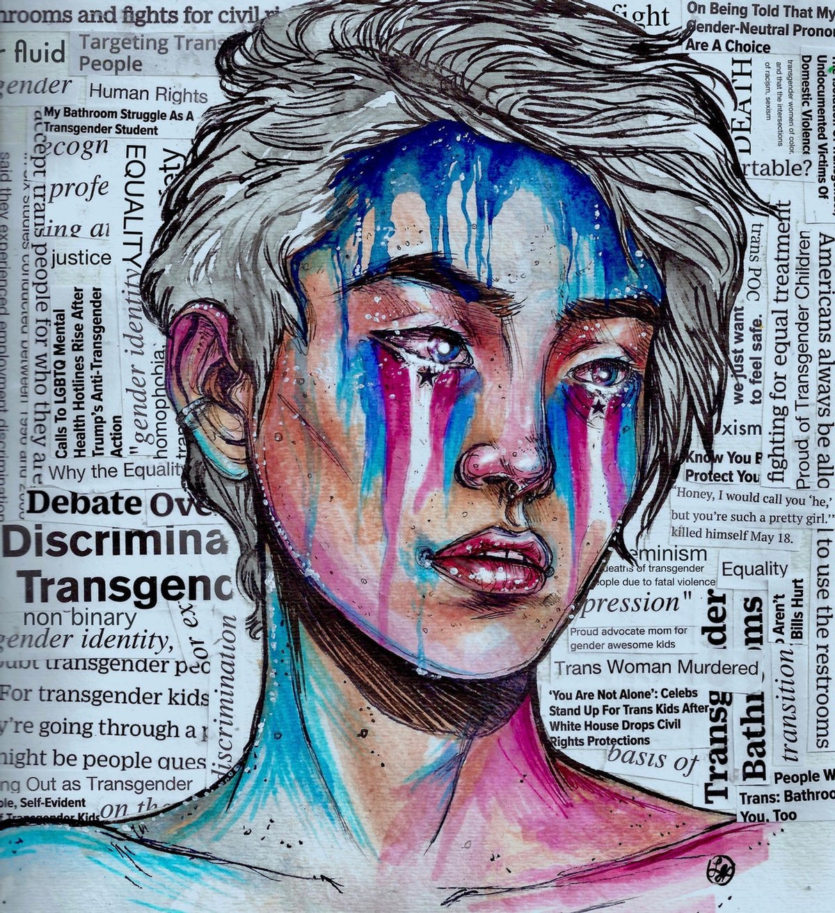
Gender Inequality
Artist: Wicketcity
The Transgender Community

Slide 2
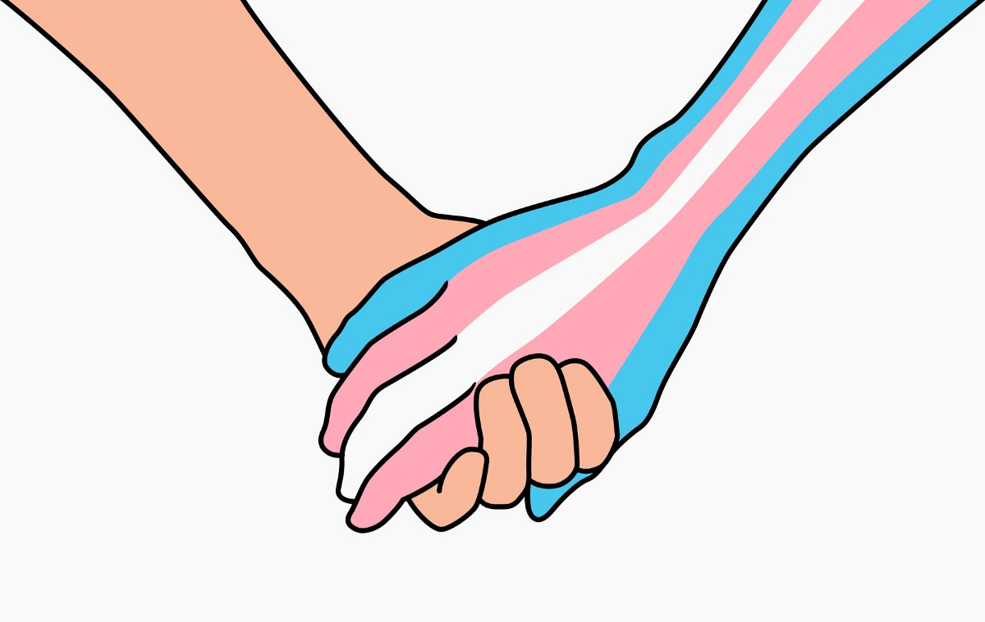
MISSION STATEMENT
Our mission is to create an inclusive and informed community where trans-individuals can equitably gain access to mental health resources, services, and each other.

Slide 3
VISION STATEMENT
Vision Statement: Our vision is to serve Transgender Youth and allies through education and services that will bring knowledge and awareness to support the Sacramento region Transgender community.
Who: Transgender People
What: LGBT+ events, Gender-Health Education Program, Trans Mental Health Campaign, LGBTQ+ Social Media Networking
How: Donation; Fundraisers; Social Media Campaigns (#); Talk to representatives; Work with Nonprofit organization, schools, and community leaders

Slide 4
THE ISSUES
The trans community is largely misunderstood by the general public, therefore stigmatized in social and professional settings.
Transphobia plagues the trans community in media representation/social media and causes a deep sense of gender dysphoria affecting their mental health and wellbeing.
Trans people lack the informed care that they need in order to feel secure in their mental health and medical care.
Towards the future, we hope that the Transgender community will gain more support in all aspects of their lives from academia, sports, media platforms, laws, policies, and more.

Slide 5
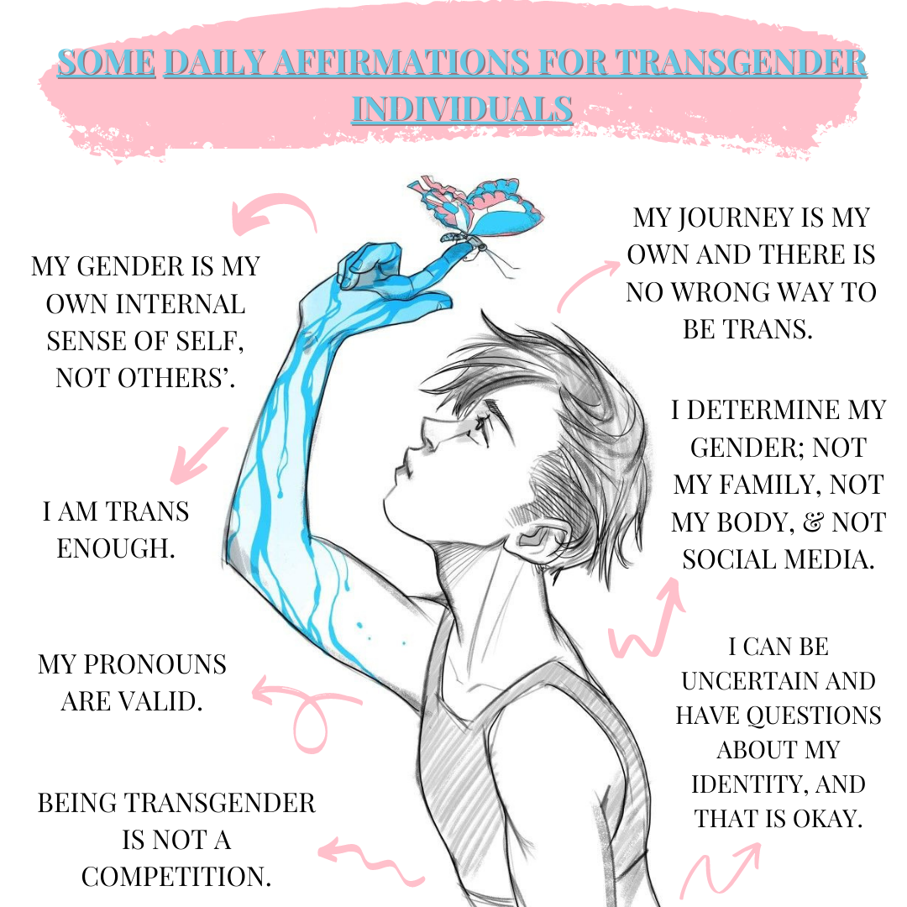
Created by @asianandlgbtq

Slide 6
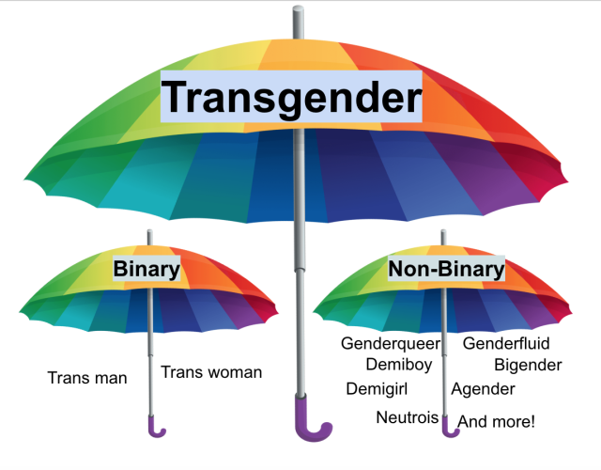
Basics To Know about the Transgender Community
Transgender is a term used to describe people whose gender identity differs from the sex they were assigned at birth.
Gender Identity is a person's internal, personal sense of being a man or a woman (or boy or girl.)
Gender Expression: How we choose to express our gender in public. This includes things like our haircut, clothing, voice and body characteristics, and behavior.
Source: GLAAD
The term “transgender” should only be used as an adjective never as a noun.
While transition-related care is critical and even life-saving for many transgender people, not everyone needs medical care to transition or live a fulfilling life.
Being Transgender is NOT a sexual identity/orientation, but only a gender identity
Source: Trevor Noah Project, TransEquality.org

Slide 7
THE TRANSGENDER COMMUNITY IS NOT A NEW “THING”
Transgender people existed in Ancient India through Hindu mythology (the oldest religion) and people known as “Hijras”.
Transgender people existed in Ancient Greece known as“galli priests”.
Transgender people existed in Ancient Thailand known as “Kathoeys” or “ladyboys”.
Trans people existed in Ancient China known as “kuaxingbie”
跨性别

Slide 8
Discrimination
&
Stigma

Slide 9
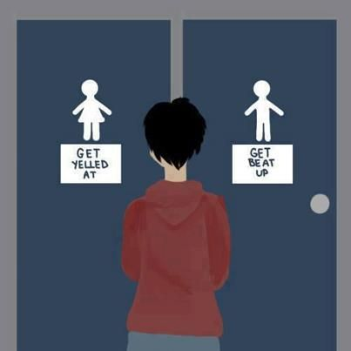
What is Gender Dysphoria?
Gender dysphoria is a term that describes a sense of unease that a person may have because of a mismatch between their biological sex and their gender identity.
(Out of body experience)
This sense of unease or dissatisfaction may be so intense it can lead to depression and anxiety and have a harmful impact on daily life.
Image Cite: From Tumblr, first appeared on ABC News Australia
Source: Department of Healthcare and Social Care

Slide 10
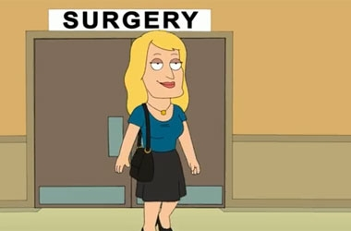
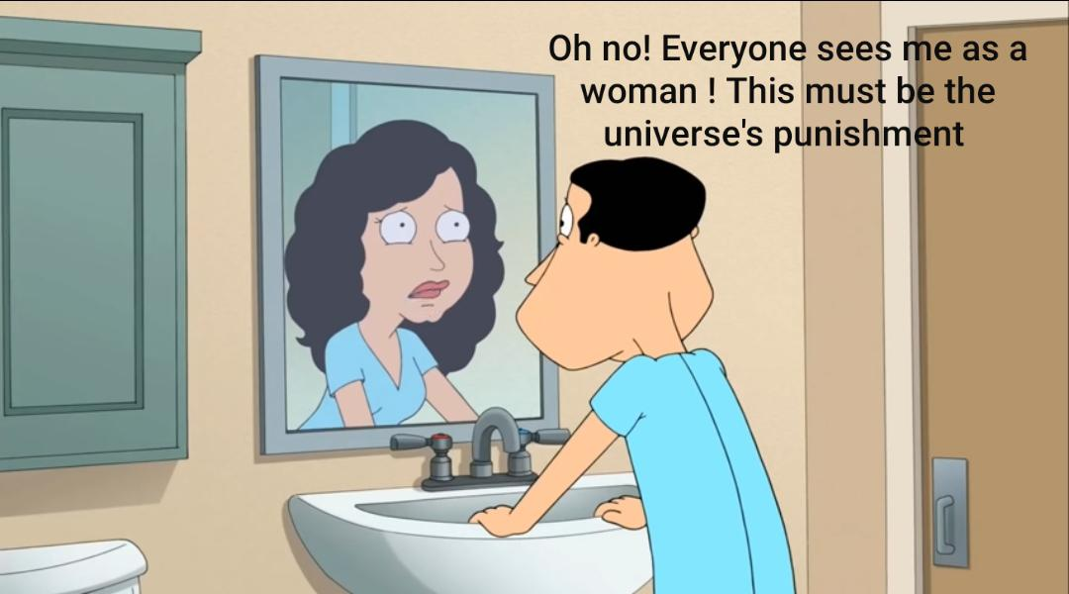
Negative Media Representation of Trans people
In a 10 year study from 2002 to 2012, GLAAD found that offensive representations and storylines were found on every major broadcast network and seven different cable networks of 101 different episodes, demonstrating that the problem remains widespread.
Transgender characters were cast in a "victim" role at least 40% of the time.
Transgender characters were cast as killers or villains in at least 21% of the catalogued episodes and storylines.
The most common profession transgender characters were depicted as having was that of sex workers, which a fifth of all characters were depicted as (20%).
Anti-transgender slurs, language and dialogue was present in at least 61% of the catalogued episodes and storylines.
Source: GLAAD
Notes:
https://innovativepublichealth.org/blog/the-influence-of-social-media-for-trans-youth/

Slide 11
Culture and Ethnicity
Many cultures have different views and names to describe gender identities
India has hijaras and kothis (Elischberger, 2018)
Hijaras can identify as a third gender or as women
Kothis are feminine men who are homosexual and may identify as women (definition is still unclear)
These people still face stigma and discrimination; live in poverty
Mexico has Muxes (Diehl, 2017)
Other identities include Brazilian travestis, Indian hijras, Mexican muxes, Fa’afafine in Samoa, the xanith in Oman, the yan daudu of Nigeria and the ‘two-spirit people’ in some Native American cultures
Typically applied to individuals who were born male but present as women
Western beliefs on gender are very binary (Elischberger, 2018)
Begins as soon as child is born
Viewed as not “normal” if gender and sexuality roles are violated
Attitudes are more negative than Asian counterparts (Elischberger, p.146, 2018).
Allows people to justify harm because it needs to be “fixed”
Notes:
Even through these names and acknowledgment, most of these countries struggle to implement policies that keep these people safe. In the US, most families try to assimilate to Western views on gender so trans people of color are more likely to face cultural stigma from their families. The expectation of gender roles is even more violent when it comes to men performing femininity. Transwomen face harmful mindsets like toxic masculinity and machismo (form of toxic masculinity in the Latinx community).
“Although all three countries have used legislation to promote provision of comprehensive healthcare services for third gender, there is still strong resistance to implementation of such laws and policies. Brazil, India and Mexico face a huge challenge to become countries where all human rights are respected” (Diehl, 2017)
Transwomen is the closest, least offensive translation to hijara (Elischberger, 2018).
Caste systems do affect the definitions for other genders in India. Kothis aren’t organized in houses or clans.
Hijaras mostly consist of those amab and adopt the “mannerisms” of women. They live in communal houses (Elischberger, 2018).
Elischberger. “Attitudes Toward and Beliefs About Transgender Youth: A Cross-Cultural Comparison Between the United States and India.” Sex roles. 78.1 (2018): n. pag. Web.
Diehl. “Social Stigma, Legal and Public Health Barriers Faced by the Third Gender Phenomena in Brazil, India and Mexico: Travestis, Hijras and Muxes.” International journal of social psychiatry. 63.5 (2017): n. pag. Web.

Slide 12
The Effect of Transphobia

Slide 13
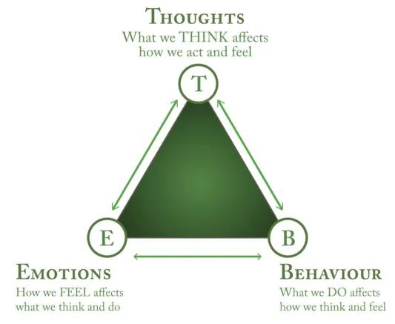
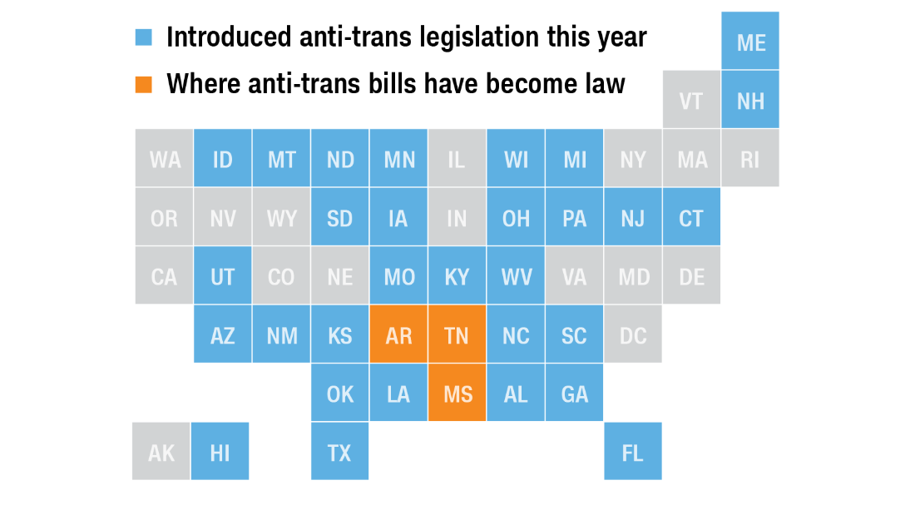
The Effect of Transphobia/Homophobia
So far in 2021, seventeen anti-LGBTQ bills have been enacted into law surpassing 2015 (when 15 anti-LGBTQ bills were enacted into law).
Anti-Trans Related Bills of the 17
7 anti-trans sports bans in Arkansas, Alabama, Tennessee, Mississippi, Montana, and West Virginia
1 anti-trans medical care ban bill in Arkansas
1 anti-trans birth certificate bill in Montana
Source: Human Rights Campaign
“Transphobia is the fear, hatred, disbelief, or mistrust of people who are transgender, thought to be transgender, or whose gender expression doesn’t conform to traditional gender roles. Transphobia can prevent transgender and gender nonconforming people from living full lives free from harm.”
Source: Planned Parenthood

Slide 14
More Effects of Transphobia/Homophobia
Comorbid psychiatric disorders (2+ illness occurring at same time)
Suicidal and self-harming risk
Drug use
Physical and mental abuse (caused especially by chronic stress and the pressure exercised by the expectations of society)
Sexually transmitted diseases*
Violence
Discrimination
Loss or lack of job that can lead to financial distress= higher risk of poverty (Puckett, 2019)
Social rejection
Late presentation for medical assistance
Lack of well-trained medical personnel
Lack of reimbursement for medical procedures involved in transition*
Notes:
Some of the issues trans people face and use to cope with abuse are these things; trans people are more likely to develop some of these things on the list as well.
Trans women of color, especially black trans women, face the highest murder rates (Dinno, 2017). “Transfeminine residents aged 15 to 34 years who were Black or Latina were almost certainly more likely to be murdered than were their cisfeminine comparators” (Dinno, 2017). The statistic was much lower from 2010-2014. The study found this surprising, however trans people are more likely to be more cautious and careful about where they travel and how they pass in order to ensure their own survival.
Dinno, Alexis. “Homicide Rates of Transgender Individuals in the United States: 2010-2014.” American Journal of Public Health, vol. 107, no. 9, Sept. 2017, pp. 1441–1447. EBSCOhost, doi:10.2105/AJPH.2017.303878.
*Cantemir, Adrian, et al. "MEDICAL AND SOCIAL ASSISTANCE FOR THE TRANSGENDER COMMUNITY: DIFFICULTIES AND PARTICULARITIES IN PSYCHIATRIC AND PSYCHOTHERAPEUTIC ASSISTANCES." Revista de Cercetare si Interventie Sociala 74 (2021).

Slide 15
Disparity in Informed Medical Care

Slide 16
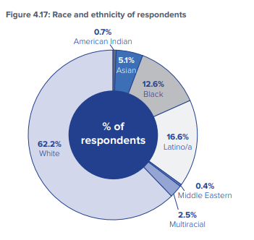
Lack of Trans Educated/Informed Care
“The 2015 U.S. Transgender Survey (USTS) is the largest survey examining the experiences of transgender people in the United States, with 27,715 respondents from all fifty states, the District of Columbia, American Samoa, Guam, Puerto Rico, and U.S. military bases overseas.” (USTS 2015 Report)
33% (9,146) of those who saw a health care provider had at least one negative experience related to being transgender
23% (6,375) of respondents reported that they did not seek the health care due to fear of being mistreated as a transgender person
33% (9,146) did not go to a health care provider when needed because they could not afford it
55% (15,243) of those who sought coverage for transition-related surgery in the past year were denied
31% (8,592) indicated that none of their health care providers knew that they were transgender
40% (11,086) reported that their healthcare provider knew they were transgender
Notes:
Cantemir, Adrian, et al. "MEDICAL AND SOCIAL ASSISTANCE FOR THE TRANSGENDER COMMUNITY: DIFFICULTIES AND PARTICULARITIES IN PSYCHIATRIC AND PSYCHOTHERAPEUTIC ASSISTANCES." Revista de Cercetare si Interventie Sociala 74 (2021).

Slide 17
How Can I Be An Ally?

Slide 18
According to Human Rights Campaign:
Familiarize yourself with different pronouns
Use books/videos to anchor your conversations about Trans people
Using gender neutral/inclusive language (Ex: They, guests, cohort, yall, colleagues, etc)
Be mindful of microaggressions (Ex: Did you have surgery yet? It’s so cool to have trans friends. You’re too pretty to ever been a man.)
Support Local organizations, national causes
According to a study done by Puckett,**
Social support can increase resilience in trans people and “reduce psychological distress” (Puckett, 2019)
Social support can come from family AND/OR friends
According to Cantemir:
Inclusive health policies
Interdisciplinary research for ALL those entering Medical fields
Inclusive settings that allow for positive responses to gender expression
Respecting names and pronouns
Nonjudgmental attitudes
Sexual minority sensitive care and sexual education
Transgender Competency Trainings
Notes:
**Puckett, Jae A., et al. "Mental health and resilience in transgender individuals: What type of support makes a difference?." Journal of Family Psychology 33.8 (2019): 954.
Social support is mainly done by friends as families tend to reject there trans children. However this is more helpful towards transwomen than transmen and can also cause some anxiety because of their identities being disclosed (Pucket, 2019). Familial support is also the strongest.

Slide 19
Trans Informed Resources
Community Resources

Slide 20
Sacramento Trans-Friendly Services
National Trans-Friendly Services
This is not an exhaustive list of Trans resources, but some of the major LGBTQIA+ Resources.

Slide 21
References
Cantemir, Adrian, et al. "MEDICAL AND SOCIAL ASSISTANCE FOR THE TRANSGENDER COMMUNITY: DIFFICULTIES AND PARTICULARITIES IN PSYCHIATRIC AND PSYCHOTHERAPEUTIC ASSISTANCES." Revista de Cercetare si Interventie Sociala 74 (2021).
Puckett, Jae A., et al. "Mental health and resilience in transgender individuals: What type of support makes a difference?." Journal of Family Psychology 33.8 (2019): 954.
Diehl. “Social Stigma, Legal and Public Health Barriers Faced by the Third Gender Phenomena in Brazil, India and Mexico: Travestis, Hijras and Muxes.” International journal of social psychiatry. 63.5 (2017): n. pag. Web.
https://transequality.org/sites/default/files/docs/usts/USTS-Full-Report-Dec17.pdf
https://transequality.org/issues/resources/frequently-asked-questions-about-transgender-people
“2021 Officially Becomes Worst Year in Recent History for LGBTQ State Legislative Attacks as Unprecedented Number of States Enact Record-Shattering Number of Anti-LGBTQ Measures Into Law.” HRC, www.hrc.org/press-releases/2021-officially-becomes-worst-year-in-recent-history-for-lgbtq-state-legislative-attacks-as-unprecedented-number-of-states-enact-record-shattering-number-of-anti-lgbtq-measures-into-law.
Dinno, Alexis. “Homicide Rates of Transgender Individuals in the United States: 2010-2014.” American Journal of Public Health, vol. 107, no. 9, Sept. 2017, pp. 1441–1447. EBSCOhost, doi:10.2105/AJPH.2017.303878.
https://www.plannedparenthood.org/planned-parenthood-northern-california/get-care/trans-health-services
https://www.glaad.org/transgender/transfaq
https://www.thetrevorproject.org/trvr_support_center/trans-gender-identity/
https://www.nhs.uk/conditions/gender-dysphoria/
https://www.glaad.org/blog/glaad-examines-ten-years-transgender-images-television-more-half-were-negative-or-defamatory
https://www.hrc.org/resources/be-an-ally-support-trans-equality

