Slide 1
Police Brutality
by : Chrysanthe Vidal, George Green, Imani Waweru, and Zoe Blackmon

Slide 2
Mission Statement: Defund the Police
Police are exceedingly militarized and as a result, disproportionately commit violence on Black, Indigenous, and other communities of color. We especially would like to highlight violence against those experiencing mental illness.

Slide 3
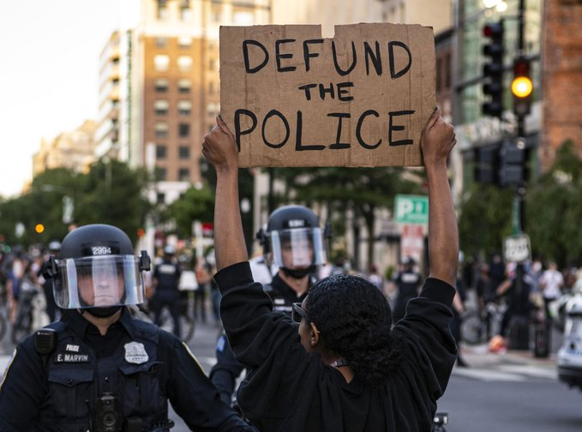
What does defunding the police look like?
Redirecting requests for police intervention
Increasing capacity for mental health response
Follow-up care
Increasing mental health police training
Bazeleon, D. L. (2020, August). "Defunding the Police" and People With Mental Illness. Retrieved from http://www.bazelon.org/wp-content/uploads/2020/08/Defunding-the-Police-and-People-with-MI-81020.pdf

Slide 4
Redirecting Requests for Police Intervention

Slide 5
Police intervention alternative services in Sacramento
Community Helpline
Community Helpline has been taking crisis calls since 1971, helping callers work through feelings that range from loneliness & depression, to suicide. Serves all of California. 8 a.m. – 8 p.m., 7 days a week. (877) 541-2525. http://chelpline.org/
Hope Cooperative Mental Health Crisis Center
Staffed 24/7 and serves any individual in Sacramento County who is at least 18 years of age experiencing a mental health crisis but is not in immediate danger to self or others. Transportation assistance available. (916) RESPITE (737-7483). https://hopecoop.org/services/
La Familia Counseling Center — Maple Neighborhood Center
Offering multi-lingual mental health crisis support. 916-210-8773. Emergency After Hours Number: 916-227-2600. https://lafcc.org/community-partnerships/
MH First
Volunteer-based mental health emergency response team for people experiencing a mental health crisis.. Can also be found on social media @mhfirstsac. 7 p.m. – 7 a.m., Fri., Sat. & Sun. (916) 670-4062.
Wellspace Health
24-Hour suicide prevention crisis line. (916) 368-3111 or (800) 273-TALK (8255). https://www.wellspacehealth.org/
There are also countless other police intervention services outside of mental health in Sacramento ranging from housing, LGBTQ+, domestic violence and sexual assault, youth, elders, crime, and substance abuse that can be found at https://dontcallthepolice.com/sacramento/

Slide 6
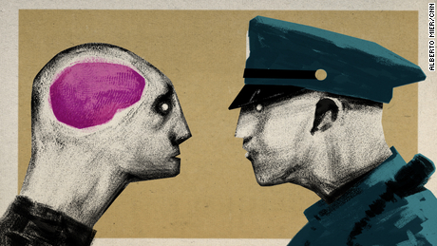
Increasing Capacity for Mental Health Response

Slide 7
CAHOOTS
CAHOOTS (Crisis Assistance Helping Out On The Streets) is a mobile crisis intervention team in Eugene and Springfield, Oregon.
“The program consists of two-person teams: one medic, nurse, paramedic, or EMT; and a crisis worker trained in social and behavioral health services. CAHOOTS calls come in through Eugene’s 911 system through which local police dispatchers are trained to recognize non-violent, behavioral health focused situations and can route calls directly to the CAHOOTS team.” (Brookings Institute 2020)
“The specialized team responds – without police officers – to first assess the situation. If necessary, the team can then call for immediate police backup; otherwise, the team stabilizes the individual within the community. When there is a case of urgent medical need or psychological crisis, the team can undertake an assessment, supply information and referrals, or provide transportation to the next step in treatment.” (Brookings Institute 2020)
“With a budget of about $2.1 million annually, CAHOOTS answered 17% of the Eugene Police Department’s overall call volume in 2017, according to the program.” (USA Today 2020)
Hauck, G. (2020, September 24). Police have shot people experiencing a mental health crisis. who should you call instead? Retrieved March 25, 2021, from https://www.usatoday.com/story/news/nation/2020/09/18/police-shooting-mental-health-solutions-training-defund/5763145002/
Bazeleon, D. L. (2020, August). "Defunding the Police" and People With Mental Illness. Retrieved from http://www.bazelon.org/wp-content/uploads/2020/08/Defunding-the-Police-and-People-with-MI-81020.pdf

Slide 8
Mental Health Response Programs cont.
Oakland Power Project - trains health professionals “to increase resistance to the everyday violence of policing, strengthen people’s skills to respond to community health needs in ways that minimize police contact, and ultimately decouple access to health care from policing.”
Support Team Assisted Response (STAR) - “dispatches health care workers to calls concerning mental health, poverty, homelessness or substance abuse when there is no evidence of criminal activity, disturbance, weapons, threats, violence, injuries or "serious" medical needs.” (The Hill 2021)
LEAD Program - law enforcement and court officials seek to avoid prison sentences for apprehended individuals with drug-related problems by providing “immediate access to substance use treatment and social services such as rental assistance, job training, and mental health programs. In exchange for their participation, no criminal charges are filed, even if they later relapse.” (Brookings Institute 2020)
Sacramento County Community Support Team - The Sacramento Community Support Team helps connect individuals to County Mental Health Services from the field to one clinician and one peer support specialist to help someone with an urgent situation get the services they need.
Albuquerque Community Safety - “The Albuquerque Police’s Mobile Crisis Team approach consists of unarmed police officers and mental health professionals responding to mental health crises [...] The two-person teams consist of one MCT-trained law enforcement officer and an MCT-trained master’s level behavioral health clinician.” (Brookings Institute 2020)
United Kingdom - in the UK, the National Health Service handles the majority of mental health calls, not the police
Bazeleon, D. L. (2020, August). "Defunding the Police" and People With Mental Illness. Retrieved from http://www.bazelon.org/wp-content/uploads/2020/08/Defunding-the-Police-and-People-with-MI-81020.pdf

Slide 9
Follow-up Care

Slide 10
“In collaboration with the healthcare system, Anne Arundel County’s Mobile Crisis Response Team also coordinates follow-up care through one-on-one care coordination when an individual is released from the Emergency Department or a jail after a mental health crisis.
When they are discharged, the crisis team picks up the individual from the hospital or jail and the clinician works with a nurse or community health worker to ensure that there is a safety plan in place.
Police officers and clinicians also work together to ensure that the individual and their family is also given an overview of the criminal justice system and collaborate on health resources when a person is arrested due to a mental health crisis.
The goal of this diversion program is to address any barrier that an individual may have so that they can adhere to their treatment plan and be successful. With this program, Anne Arundel County has experienced significantly lower recidivism rate for these individuals.” (Brookings Institute 2020)
Bazeleon, D. L. (2020, August). "Defunding the Police" and People With Mental Illness. Retrieved from http://www.bazelon.org/wp-content/uploads/2020/08/Defunding-the-Police-and-People-with-MI-81020.pdf

Slide 11
Increasing Mental Health Police Training

Slide 12
In the status quo, officers in police training academies may receive 4-12 hours of training in mental health
According to a 2015 survey by the Police Executive Research Forum, “new recruits spend about 58 hours in firearms training and eight hours in crisis intervention training.”
“Approximately 2,700 of the nation's roughly 18,000 police departments have some or all of their officers go through crisis intervention training (CIT), known as the "Memphis model" .” (USA Today)
Memphis Model — aims to help police recognize a mental health problem and get people to treatment (National Alliance on Mental Illness)
The program includes:
40 hours of training in various topics, such as mental health diagnoses, psychiatric medications and drug abuse.
teaching officers verbal de-escalation skills
Having officers spend time interacting with people who have gone through a mental health crisis.
Every officer in every police department should be required
“In 2015, Anne Arundel county became the first police department in the country to have trained every officer in mental health first aid.” (Brookings Institute 2020 )
the county’s use of force has dropped by 21 percent.
Every officer in the department now receives 8 hours of mental health first aid
4 hours of SAMHSA training, and other mental health-focused training sessions.
CIT officers “undertake a rigorous 40 hour specialized behavioral health course.” (Brookings Institute 2020)
Hauck, G. (2020, September 24). Police have shot people experiencing a mental health crisis. who should you call instead? Retrieved March 25, 2021, from https://www.usatoday.com/story/news/nation/2020/09/18/police-shooting-mental-health-solutions-training-defund/5763145002/
Bazeleon, D. L. (2020, August). "Defunding the Police" and People With Mental Illness. Retrieved from http://www.bazelon.org/wp-content/uploads/2020/08/Defunding-the-Police-and-People-with-MI-81020.pdf

Slide 13
Vision: Educational Campaign on Social Media

Slide 14
Our Vision
Who? : All who would like to end policing and police brutality
Where? : Online
What? : Virtual Campaign on Instagram/Facebook, Twitter, and other social media platforms
Why? : Give the individual tools to help to contribute to the common goal of ending police brutality
How? : Provide information and resources for use on an individual level

Slide 15
History of policing in the United States
Source: Critical Resistance. Policing in the United States and Its Origins. 2015.
“1492: colonization of the Americas by Europe begins; brutal militia force is a routine part of land-grabbing…”
“1680s: South Carolina passes a law that allows any white person to capture and punish a runaway slave. In 1690 a law was passed that required whites to act in this role…’White supremacy served in lieu of a police force’”
“1865: …[E]mancipation also stipulates that slave labor may continue for those convicted of a crime, creating an incentive for whites in power to arrest Black people in order to exploit their labor and prevent their entry into wage labor and political power (13th Ammendment)”
“1943: Detroit Riots...According to Thurgood Marshall, the police ‘used “persuasion” rather than firm action with white rioters, while against Negroes they used the ultimate force: night sticks, revolvers, riot guns, submachine guns, and deer guns.’”

Slide 16
History of policing in the United States
Source: Critical Resistance. Policing in the United States and Its Origins. 2015.
5. “1950s onwards: COINTELPRO is ultimately a key player in dismantling the radical movements for justice that emerged in this era.”
6. “1967: Advisory Commission of Civil Disorders: found that reasons for civil unrest included unemployment, job and housing discrimincation, inadequate social services, unequal justice and police actions. Kerner Commission found police were committing acts of brutality, harassment or abuse, they had little training or supervision, community relations were poor and failure to employ [B]lack officers...emphasis on hierarchy and following orders...regular contact with people is limited.”

Slide 17
History of policing in the United States
Source: Critical Resistance. Policing in the United States and Its Origins. 2015.
7. “1970s-80s: through federally funded ‘drug war’ programs and surplus equipment from the military, paramilitary police units, SWAT teams and anti-drug task forces begin springing up.”
8. “1980s: ‘Drug War’ begins at Regan’s urging, setting up urban communities of color as both victims and perpetrators in ongoing process of criminalization.”
9. “1990s: Passage of ‘Zero Tolerance’ policy, racial profiling laws like Prop 21, ‘Three Strikes Law’, and increasingly extreme enforcemen of drug laws support massive growth in the [Prison Industrial Complex] PIC.”
10. “1994: Violent Crime Control and Law Enforcement Act. $8.8 billion over 6 years to local law enforcement for hiring and acquiring new technology, hiring civilians to free up officers, and implementing new programs...By 1999, 60% of local agencies had a plan to incorporate community policing.”

Slide 18
History of policing in the United States
Source: Critical Resistance. Policing in the United States and Its Origins. 2015.
11. “1990s-2000s: Community policing model emerges around the country, encouraging homeowners, business owners, and local police to unify efforts to police the streets. This process is closely tied with urban gentrification…”
12. “1998-2000: Rampart/CRASH (Community Resources Against Street Hoodlums) anti-gang unit in LA scandal. More than 70 police officers in the CRASH unit were implicated in misconduct…[including] unprovoked shootings, unprovoked beatings, planting evidence, framing of suspects, stealing and dealing narcotics, bank robbery, perjury, and covering up evidence of these activities.”

Slide 19
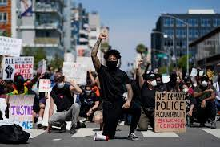
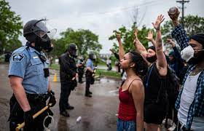
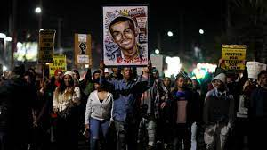
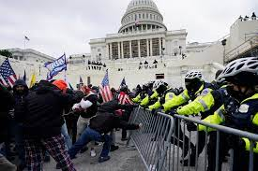
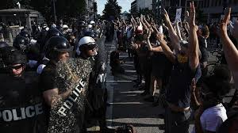
13.

Slide 20
Tips for an individual to help contribute to ending policing and police brutality.
“Regardless of your field of work, evaluate whether policies, laws, requirements, guidelines, etc. have unintentional negative consequences for people of color.”
Alang, Sirry, and Opinion contributor. “How to Dismantle Racism and Prevent Police Brutality.” USA Today, Gannett Satellite Information Network, 12 May 2017, www.usatoday.com/story/opinion/policing/2017/05/12/how-dismantle-racism-and-prevent-police-brutality/101481438/.
Consider becoming trained as a cop watcher
https://uaptsd.org/copwatch/copwatch-training-manual/
Donate directly to those impacted by police brutality.
Look for calls for mutual aid, check GoFundMe, or donate through Venmo/Paypal/Cashapp or others.
“Black Lives Matter Activists Denounced by Mothers of Victims for Exploiting Deaths of Tamir Rice and Others Killed by Police.” World Socialist Web Site, 19 Mar. 2021, www.wsws.org/en/articles/2021/03/20/blma-m20.html.

Slide 21
Quantitative Statistics
In 1996 Congress shifted from the 1208 plan to the 1033 plan. Which heavily militarized law enforcement
-; Wofford, Taylor. “Newsweek.” Newsweek.Com, Newsweek, 13 Aug. 2014, www.newsweek.com/how-americas-police-became-army-1033-program-264537.
-;Due to this shift law enforcement has received $4.3 billion dollars in military style equipment.
-; Wofford, Taylor. “Newsweek.” Newsweek.Com, Newsweek, 13 Aug. 2014, www.newsweek.com/how-americas-police-became-army-1033-program-264537.
People with untreated mental illness are 16 times more likely to be murdered by police officers.
Meraw, Shannon. “Brookings.” Brookings.Edu, 23 Nov. 2020, www.brookings.edu/research/innovative-solutions-to-address-the-mental-health-crisis-shifting-away-from-police-as-first-responders.
Those with severe mental illness, such as schizophrenia are 10 times more likely to be sent to a cell, rather than a hospital bed.
Meraw, Shannon. “Brookings.” Brookings.Edu, 23 Nov. 2020, www.brookings.edu/research/innovative-solutions-to-address-the-mental-health-crisis-shifting-away-from-police-as-first-responders.
Police receive 4-12 hours of mental health training in the police academy.
Meraw, Shannon. “Brookings.” Brookings.Edu, 23 Nov. 2020, www.brookings.edu/research/innovative-solutions-to-address-the-mental-health-crisis-shifting-away-from-police-as-first-responders.

Slide 22
Causes
The origin of the Police is rooted in racism, through their genesis as slave catchers.
-Pinkney, Alphonso. Black Americans. 5th ed., Pearson, 1999.
Red Summer of 1919
-Pinkney, Alphonso. Black Americans. 5th ed., Pearson, 1999.
Police are not required, by law to report on duty murders.
Hellman, Jaime. “Al Jazeera.” Al Jazeera, 28 May 2015, america.aljazeera.com/watch/shows/Ali-Velshi-On-Target/articles/2015/5/28/No-data-on-how-many-killed-by-police-in-America.html.

Slide 23
Effects
Viewing people of Color as the enemy
-Nolan, Tom. “Defense One.” Defense One, 24 June 2014, www.defenseone.com/ideas/2014/06/stop-arming-police-military/87163.
Converting Africanity into a weapon
Criminalization of people of the African DIaspora
-Change, Community. “Community Change.” Communitychange.Org, 8 July 2020, communitychange.org/wp-content/uploads/2020/07/a_brief_history_of_policing_blackness_in_america.community_change.7.2020.pdf.
African people seen as a threat to the white power stucture
Guilty until Proven innocent

Slide 24
Community Resources
Sacramento - all sources on this website
A Community For Peace – Ruthie’s Place
Youth drop-in center; this is the beginning of a targeted harm reduction project targeting at-risk from marginalized populations, foster care youth, LGBTQ+ youth, youth experiencing domestic violence, and those youth currently being exploited and trafficked throughout Sacramento County.
Crisis Line: (916) 728-7210
General: (916) 917-5450
(Please note, people answering these calls may be mandatory reporters, and required to make a report to CPS or law enforcement in certain situations.)
AMALA Muslim Youth Hopeline
Warmline for Muslim youth experiencing mental health and other challenges
6 p.m. – 10 p.m., 7 days a week
(855) 95-AMALA
Text available at the same number Wednesdays and Sundays
http://amala.mas-ssf.org/

Slide 25
“Community Helpline has been taking crisis calls since 1971, helping callers work through feelings that range from loneliness and depression, to suicide. Serves all of California. 8 a.m. - 8 p.m., 7 days a week. (877) 541-2525 http://chelpline.org/ “
“American River Area Narcotics Anonymous. 24-hour helpline designed to help any addict, any time, day or night that is seeking help. (800) 600-HOPE (4673) or (866) 565-2135 http://sacramentona.org/ “
“WEAVE’s mission is to promote safe and healthy relationships and support survivors of sexual asault, domestic violence and sex trafficking. (9116) 920-2952 (24/7 Crisis Support Line) https://www.weaveinc.o
Sacramento - all sources on this website

Slide 26
Housing
211 Sacramento is the area’s primary information and referral source for all types of services. 211 provides free, confidential information and referral services 24-hours a day, seven days a week. Referrals can be made to more than 1,600 community services in the Sacramento area, including emergency housing and food services. https://www.sacselfhelp.org/find-housing.html
211 or 1 (800) 500-4931 or (916) 498-1000
A Community For Peace – TAPESTRY services
ACFP’s TAPESTRY program provides emergency housing, legal advocacy, counseling and other services through an all-LGBQ and Transgender staff that reflects the community it seeks to serve. https://acommunityforpeace.org/tapestryservices
Crisis Line: (916) 728-7210
General: (916) 728-5613
A Community For Peace
Serving children and adult survivors of domestic violence and sexual assault throughout Sacramento and the surrounding areas https://acommunityforpeace.org/
Crisis Line: (916) 728-7210
General: (916) 728-5613

