Slide 1
Hate Crimes and Discrimination in the United States During the COVID-19 Pandemic
With a Focus on Race and Gender

Slide 2
Created by:
-Isaija Anaya
-Mariah Padilla
-Ti’Ana Lewis
-Bailey Waldrep
Notes:
Introduce ourselves

Slide 3
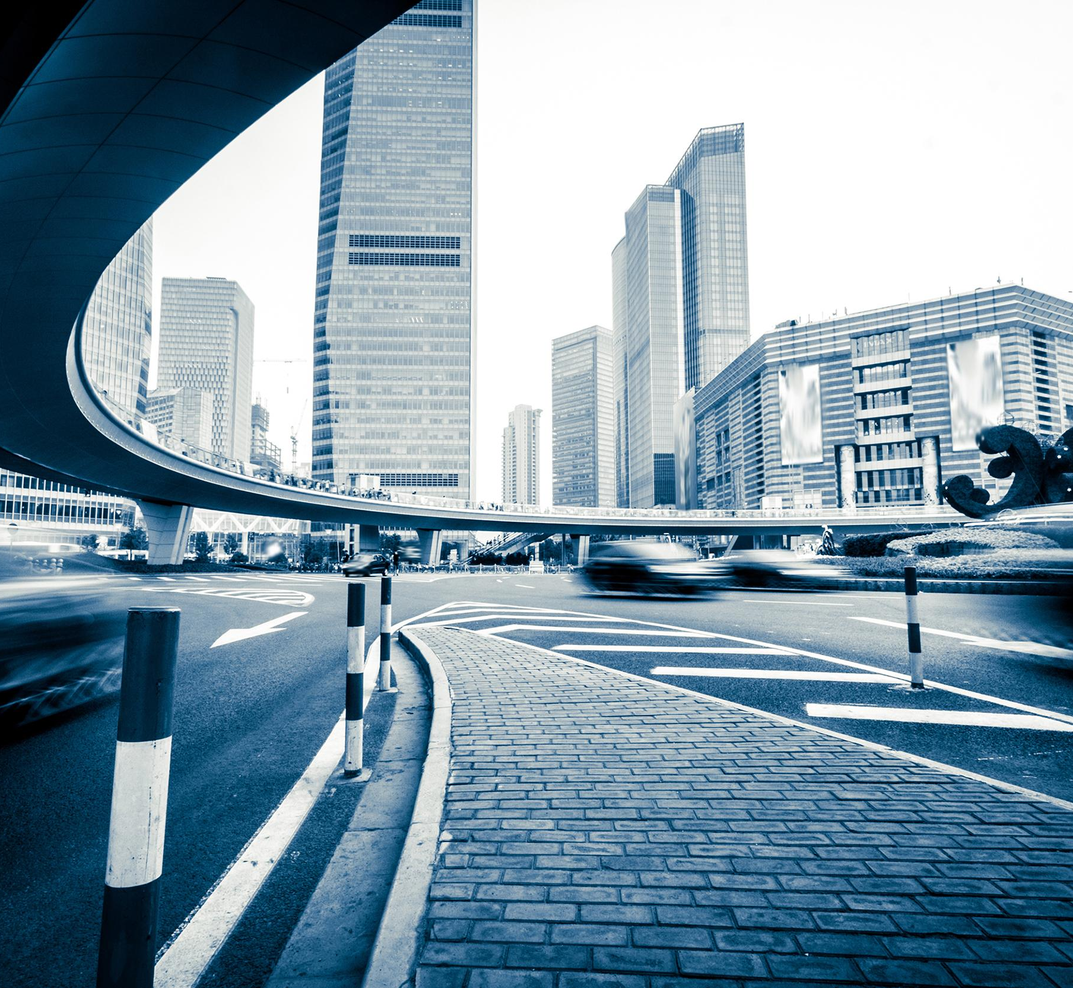
Mission Statement or objective:
Our mission is to bring social awareness to the exacerbation of gender and racial inequality in the United States due to the COVID-19 pandemic.
Notes:
Isaija

Slide 4
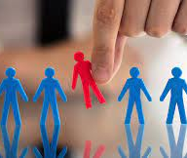
Defining terms:
Discrimination: The unjust or prejudicial treatment of different catagories of people or things, especially on the grounds of race, age, or sex.
Notes:
Tiana

Slide 5
Defining terms:
Race: Each of the major groupings into which humankind is considered (in various theories or contexts) to be divided on the basis of physical characteristics or shared ancestry.
The fact or condition of belonging to a racial division or group, or the qualities of characteristics associated with this.
Gender: either of the two sexes (male and female), especially when considered with references to social and cultural differences rather than biological ones. The term is also used more broadly to denote a range of identities that do not correspond to established ideas of male and female.
Notes:
Tiana

Slide 6
Issue at Hand
-Quantitative Evidence
-Causes
-Effects
Notes:
Tiana

Slide 7
Quantitative Evidence and Effects:
Ti’Ana - I’ve experienced more racial profiling since the start of the pandemic. It effects me because it makes me feel I don’t belong as a Black and Asian American
Bailey - I experienced an increase in catcalls and homophobic behavior during and since the panademic. It affected me by hurting my self esteem and self image
Mariah - Due to the rise of the Anti-Asian sentiment during the pandemic and the increase in Asian hate crimes, especially towards older Asian folks, I have felt more concerned about my safety, the safety of my family, and my grandparents.
Isaija - During the start of the pandemic, my concern for not just my well-being, but for my family’s well-being as well, grew. I also
Notes:
Everybody

Slide 8
Have you been affected? How have you been affected?

Slide 9
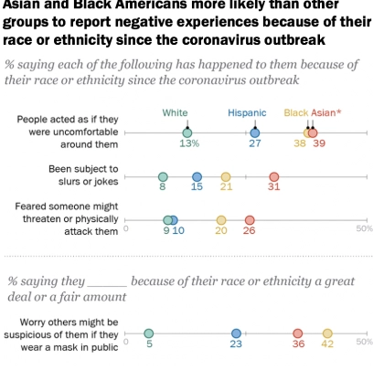
Statistics:
Asian and Black Americans more likely than other groups to report negative experiences because of their race or ethnicity since the coronavirus outbreak.
58% of Asian American adults stated that it is more common for people to express racist or racially insensitive views about people who are Asian than it was before the coronavirus outbreak
45% of Black adults more common for people to express racist views about Black people than before the outbreak
In 2020, at least 11 transgender or gender non-conforming people have been killed, including seven Black transgender women in Florida over the past two years and reports of a Black transman killed by police earlier this week in Florida
Notes:
Bailey

Slide 10
Causes
-US President Donald Trump’s use of the term “Chinese virus” and Secretary of State Mike Pompeo’s use of “Wuhan virus” may have encouraged the use of hate speech in the US.
-The difference this time around is the contemporaneous outbreak of the COVID-19 pandemic, which has contributed to making these protests more enduring and widespread. COVID-19 has exacerbated the problems of racial injustice, isolation, frustration and stagnation and caused higher unemployment, which provides the time to air these grievances. When coupled with mixed messages from elites, the spark lit a fire that continues to burn.
Notes:
Bailey

Slide 11
Our Vision
Introducing The Global Majority, a One Stop Shop Resource Center
Who? Minorities (ie. Racial minorities, LGBTQIA+ community, Womxn) who have been targeted and oppressed because of/since the pandemic
Where? The United States, specifically regions where there are large populations of underserved communities
What? A one stop shop resource center
Why? To make a safe welcoming space where marginalized communities can receive access to critical resources
How? By gathering resources and professionals to assist said minorities.
Notes:
Mariah

Slide 12
How will our vision be implemented?
The Global Majority
Our Motto: By the Global Majority for the Global Majority.
Our Mission: Our one-stop resource center will serve as a safe space dedicated to providing community-informed and culturally sensitive care, resources, and services to community members in need. Through our services we aim to create a sense of community and safety in a time in which racism, hate crimes, and discrimination have increased exponentially.
Notes:
Mariah

Slide 13
How will our vision be implemented?
The Global Majority
Logistics:
Host outreach events and campaigns to promote our services
Provide avenues in which community members can provide insight and suggestions on what services they need and how services can be improved
Community Forums, Surveys, Text Hotline
Staff members will have lived experience and be representative of the population they are serving
Notes:
Mariah

Slide 14
What services would we aim to provide?
Access to Contraception
Legal Counseling and Assistance
Health Clinic
Mental Health Services
Comprehensive Sex Education
Workforce Development and Resume Building
Access to Food and Basic Needs Resources and Information
Housing Assistance for Unhoused Community Members
Childcare Services
Translation Services
Community Kitchen and Garden
** All resources and services would be culturally-informed and community driven
Notes:
Mariah

Slide 15
Prevention
Primary: Comprehensive Sex Education, Access to Contraceptives, Workforce Development
These types of services would strengthen our communities and provide them access to resources and information that they can use to change their lives and their families
Secondary: Access to Food and Basic Needs Resources, Community Kitchen and Garden
These types of resources would mitigate the most pressing issues faced by marginalized community members and allow them to rest, feel safe, and to care for themselves/family
Tertiary: Mental Health Services, Legal Assistance, Housing Assistance, Child Care Services, Translation Services
These types of resources are very long term and can help community members receive the medical care they require, gain long term stability, and build generational resilience
Notes:
Isaija

Slide 16
Community Resources
Planned Parenthood (Family Planning, Abortions, Basic Health Care, Sex Education, STI Screening, etc)
https://www.plannedparenthood.org/
National Alliance on Mental Illness (NAMI) (Mental Health Services and Advocacy)
https://nami.org/Home
Coalition of Concerned Legal Professional (CCLP) (Free and voluntary, unincorporated private membership association of attorneys, paralegals, law students and others who have united to commit time, resources and skills to fight the lack of meaningful access to legal recourse available to underserved communities)
https://www.cclpbayarea.org/
Notes:
Tiana

Slide 17
References:
(Gender)
https://unfoundation.org/blog/post/shadow-pandemic-how-covid19-crisis-exacerbating-gender-inequality/
MICHELLE MILFORD MORSE AND GRACE ANDERSON ON APRIL 14, 2020
https://www.americanprogress.org/issues/women/news/2020/05/29/485606/protecting-promoting-womens-rights-key-defeating-coronavirus-home-abroad/
By Shilpa Phadke and Alexandra Schmitt May 29, 2020

Slide 18
Resources:
(Race)
https://www.pewresearch.org/social-trends/2020/07/01/many-black-and-asian-americans-say-they-have-experienced-discrimination-amid-the-covid-19-outbreak/
PEW RESEARCH CENTER, JULY 1, 2020
https://www.hrw.org/news/2020/05/12/covid-19-fueling-anti-asian-racism-and-xenophobia-worldwide
Human Rights Watch, May 12, 2020
https://theconversation.com/black-lives-matter-movement-finds-new-urgency-and-allies-because-of-covid-19-141500
Reza Nakhaie and F.S. Nakhaie

Slide 19
Resources:
(Discrimination)
https://www.cdc.gov/eeo/faqs/discrimination.htm#9
By the CDC

Slide 20
Inspiring Quotes
“Let us all hope that the dark clouds of racial prejudice will soon pass away, and that in some not too distant tomorrow the radiant stars of love and brotherhood will shine over our great nation with all their scintillating beauty.” - Martin Luther King, Jr.
“In times of crisis the wise build bridges, while the foolish build barriers.”- T’Challa

