Slide 1
Homelessness leading to mental health issues
By: Jay Franco, Kamani Reichling, Ethan Benabides, Chelsea Rodriguez

Slide 2
Disclaimer
There are some points discussed in our presentation that might be overwhelming for some people.They will be brief but still important to acknowledge. As always, feel free to step away if needed.

Slide 3
Objective:
Discussing homelessness and raising awareness
Discuss homelessness in general context
Sacramento’s homeless community overview
Youth homelessness
California housing laws and Sacramento’s plan to help the homeless

Slide 4
Overview
Of
Homelessness
in
the United States
Many experience depression, schizophrenia, substance abuse, psychotic disorders, and personality disorders
Most homeless women and men population are between 31 to 50 years of age, unmarried, and unemployed
More homeless women suffer from major mental illness
Age has a big factor in different variability in terms of mental disorders
Older homeless individuals are more likely male, report low income and poor health, lifetime alcohol-use disorder
Notes:
Chelsea’s slide
https://www.jstor.org/stable/41344992 (most used source for me)

Slide 5
Health Issues Associated
Homeless children in the U.S. experience high number of acute-illness symptoms
Fever, ear infections, diarrhea
The general population experiences:
Asthma, cardiovascular disease, cuts and gynecologic problems
The most important risk is tuberculosis
Homeless mothers report high levels of pain and high prevalence of asthma, tuberculosis, anemia, and ulcer disease
Women and men (between 13 to 21 years of age) significantly linked with Hepatitis B infections
Notes:
-There are several physical health issues that correlate with homelessness that can be caused by the environment they are surrounded by (unsanitary)

Slide 6
Risk Factors for Homelessness
Policy-makers failings are the most likely explanation
Complicated combinations of mental, physical, social, and economic problems also play a role
Low level of support systems
Physical and sexual abuse
Residential instability
Delinquent Behavior
Foster care placement
History of substance abuse
Family conflict or interpersonal conflict
Feeling unloved in childhood
Adverse childhood experiences - 56% reported more than 4 ACEs
Social poverty, economic poverty
limited commitment to providing resources
Mental Disorders
Reports of substance abuse, schizophrenia, and a number of stressful life events
Lack of protective factors!
Notes:
-These are some risk factors that can lead to homelessness. Obviously, if someone were to experience one of these factors, it doesn’t mean that they are bound to be homeless, it just increases the risk
-

Slide 7
Mental Health Issues
For adolescents, homelessnes was an separate predictor for depression and anxiety
Quality of life of homelessness related to severe depressive symptoms
Isolation from social networks increased levels of depression among homeless mothers
Homeless men demonstrated high frequency of comorbid mental disorders
Mood disorders, anxiety disorders, drug abuse, dependency, and psychotic disorders
In the U.S., psychotic disorders among the homeless is estimated to be 40%
15% of the sample in American patients had experiences at least one episode homelessness within 24 months of their first hospitalization
Notes:
-there is also a correlation with stress being involved
-

Slide 8
Substance Abuse : A Factor
In the United States, substance abuse disorder rates range from 29%-50%
10%-20% of homeless individuals had dual diagnosis of mental disorders and substance abuse
72% of homeless individuals are affected by the use of heroin and cocaine
Alcohol abuse/dependency is a major factor creating homelessness
Experienced more than 5 years report have rates of alcohol abuse and drug abuse
Yonder women were more likely to experience alcohol problems than older women
Drinking associated problems increase the risk of homelessness and reduce the protection given by social networks
Causing to the stimulation of complicated health problems
Among those with comorbid mental disorders, alcohol use was slightly greater
Notes:
-the US has the highest rate for the use of heroin and cocaine compared to other countries that report from 50% to as low as 20%
-using substances as mentioned can be away to calm down the anxiety and stress associated with homelessness especially a person has been homeless for years

Slide 9
Substance Abuse & Schizophrenia
Half of the homeless community with schizophrenia might suffer from comorbid of substance abuse
Assocaited with a variety of factors: homlessness, violence, poor treatment compliance, medical problems, suicide
Those with high symptoms have a higher risk of prehospitalization homelessness than those with low symptoms
Women experiencing homelessnes showed higher rates of positive symptoms, current diagnosis of drug abuses, and antisocial personality disorder
Less adequate family support
Homeless men who experienced schizophrenia meet the criteria for antisocial personality order
Notes:
-from looking over this research, homelessness typically 2 or more factors involved that increased the risk of being homeless and can be a barrier between the person and getting help
-different criteria for men and women and how they can be perceived as well with their symptoms

Slide 10
Demographics Overview
Adults
Women and children are the fastest growing segment in the U.S.
13% of men and 3% of women with mental disorders were 50 years or older
Women and white individuals report the suggested cause to be personal and family problems
Nonwhites report the suggested cause was poverty
In the United States, 49.5 million - 9.32 million are homeless
67.5% were reported to be African American
Youth
52% of children over 4 years old from homeless families develop behavioral issues
Younger individuals meet the criteria for lifetime drug-use disorders and posttraumatic stress disorder
Families with children is estimated to be 37% of homeless population - fastest growing segment
Notes:
-Those over 50 show how the age range can vary the impacts of homelessness such as mental health, physical health
-youth are more vulnerable to have more issues in life than older people
-causes of homeless can vary as well by the ethnic and racial group as mentioned in earlier slides

Slide 11
Sacramento’s Overview of the Homeless Community
Half of all homeless population in Sacramento are people of color
Majority of homeless population are veterans, youth, people who suffer from substance abuse and/or mental illness
Around 70% of homeless people are living in the streets without a roof over their head
According to the SacBee, 20% of homeless people are families and have children
According to KCRA. some causes of homelessness include rent pricing, lack of substance abuse and mental health resources, and limited space in shelters
Notes:
Ethan slides

Slide 12
Notes:
Ethan’s slides

Slide 13
Youth Homelessness
One in 10 young adults ages 18-25 experienced homelessness over the course of a year
At least one in 30 adolescents ages 13-17 experienced homeslessness in a year
50% of homeless youth have been in the juvenile justice system, in jail or detention.
Lack of a high school diploma or General Equivalency Diploma (GED) is the number one correlate for elevated risk of youth homelessness.
62% of LGBTQ youth report physical harm while homeless
47% of non-LGBTQ youth report physical harm while homeless.
Risk factors for being homeless: family dynamics or conflict, sexual orientation (LGBTQ), sexual activity, school problems, pregnancy, substance use, being Hispanic or Black, parenting and unmarried, and foster care.
Young people are biologically more likely to engage in high-risk behaviors, such as unsafe sexual activity and substance use
“Each year, an estimated 4.2 million youth and young adults experience homelessness, of which 700,000 are unaccompanied minors, meaning they are not part of a family or accompanied by a parent or guardian. On any given night, approximately 41,000 unaccompanied youth ages 13-25 experience homelessness.”

Slide 14
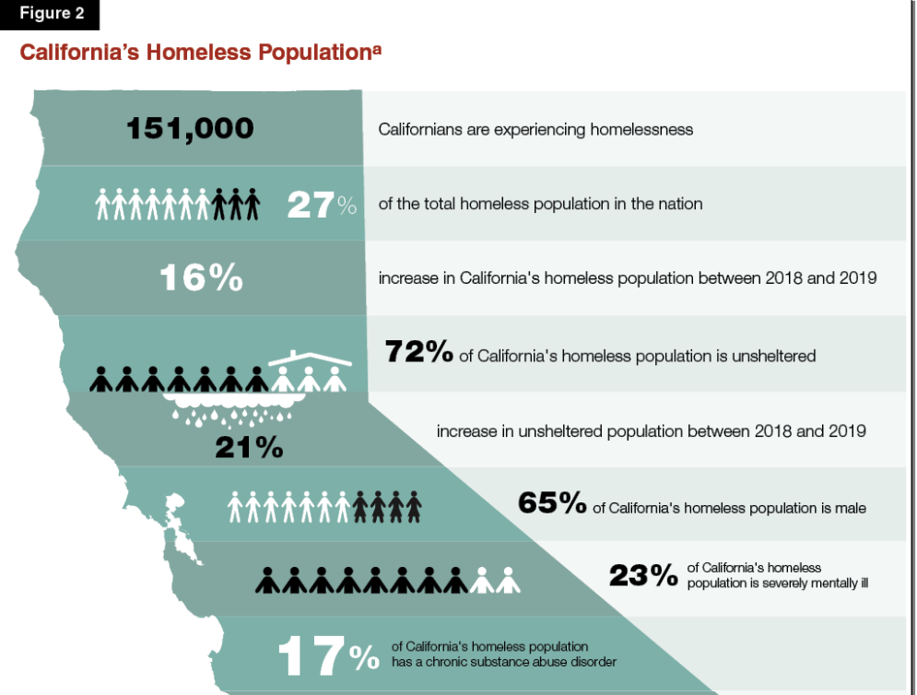
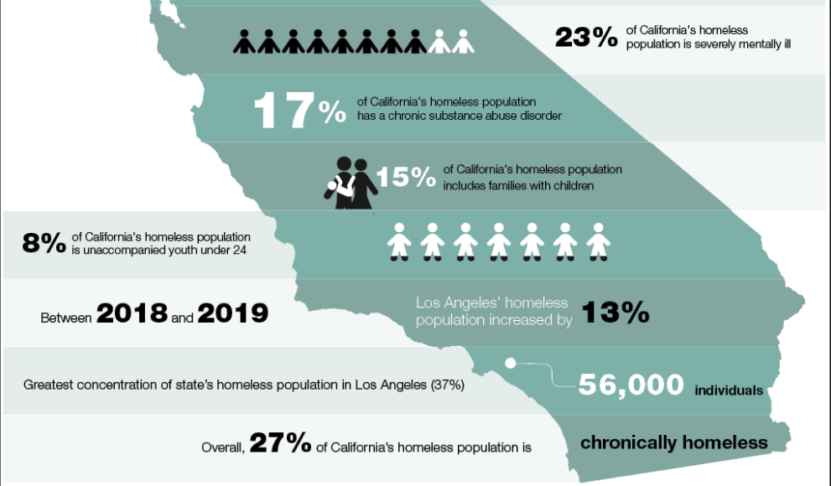
California Overview
*Based on the U.S. Department of Housing and Urban Development’s 2019 point-in-time homeless count.
Notes:
This was based on the US department of housing and urban development in 2019

Slide 15
Jay’s Hot Take
Vellinga, M. L. (2021, July 1). Read the full text of Mayor Darrell Steinberg's 2021 State of the City Address. Mayor's Office of Civic Engagement. https://engagesac.org/blog-civic-engagement/2021/6/29/read-the-full-text-of-mayor-darrell-steinbergs-2021-state-of-the-city-address.
KQED. “The California Report.” 2 July 2021, https://podcasts.apple.com/us/podcast/kqeds-the-california-report/id79681292?i=1000527627348
Voices River City. “165-Oil Baron Summer.” 6 July 2021, https://podcasts.apple.com/us/podcast/voices-river-city/id1277695447?i=1000527960170

Slide 16
Community Resources
https://sacloaves.org/
Loaves & Fishes helps homeless individuals by providing food, clothes, and a safe shelter
https://bgmhsacramento.org/
Bishop Gallegos Maternity Home provides shelter to pregnant women who are experiencing homelessness due to vulnerable situations
https://www.211sacramento.org/211/
One can find different resources that provide services for homeless individuals such as food and shelters
https://www.sacramentofoodbank.org/
Helps provide food resources to low income and homeless individuals
Notes:
Chelsea’s Slide
-some local resources that I had worked in the past with or have interacted with that can be helpful for people

Slide 17
Questions?

Slide 18
Sources
Martens, Willem H.J. “Homelessness and Mental Disorders: A Comparative Review of Populations in
Various Countries.” International Journal of Mental Health, vol. 30, no. 4, 2001, pp. 79–96. JSTOR, www.jstor.org/stable/41344992. Accessed 7 July 2021.
Scherer, Sarah, and Shannon Saul. Youth Homelessness Overview, National Conference of State
Legislatures, www.ncsl.org/research/human-services/homeless-and-runaway-youth.aspx.

