Slide 1
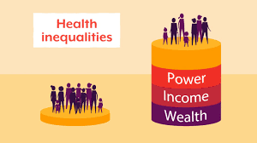
Healthcare Inequity
Alexis, Jaelyn, Mario, Valeria, Yazmin
Notes:
Present: Mario

Slide 2
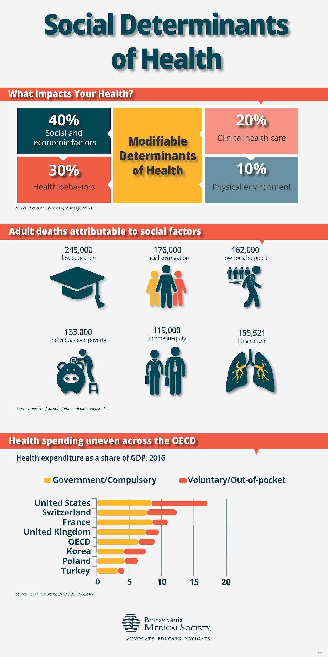
Mission Statement
Our goal is to find a way to reduce healthcare inequities in the medical system by providing resources in our community that focus on preventing mental health inequalities.
Notes:
Present:Mario

Slide 3
Issue at Hand(mario)
Lack of insurance coverage for all
High medical costs
Cultural barriers between patients and clinicians
Disproportional relationships between doctors, pharmaceutical companies and patients
Notes:
Present:Mario

Slide 4
Our Vision
Why?
Many high school students struggle with their mental health and might not have the access or the knowledge to find solutions
How?
We will be giving solutions, resources, and statistics based on how actual high school students In Sac feel about mental health and healthcare.
Who?
Youth- More specifically, High school students in Sacramento
What?
Mental Healthcare inequities
Notes:
Present:Yazmin

Slide 5
Prevention
• One way to prevent healthcare inequities is diversifying the healthcare workforce to more closely reflect the demographic composition of the patient population.
Notes:
Present:Alexis

Slide 6
Primary - aims to prevent the issue before it occurs and increase resistance
Implementing prevention programs to prevent mental health disparities from occurring in regards to quality healthcare access
Ex: Peers Helping Peers, Health Education Council etc.
Notes:
Present: Mario

Slide 7
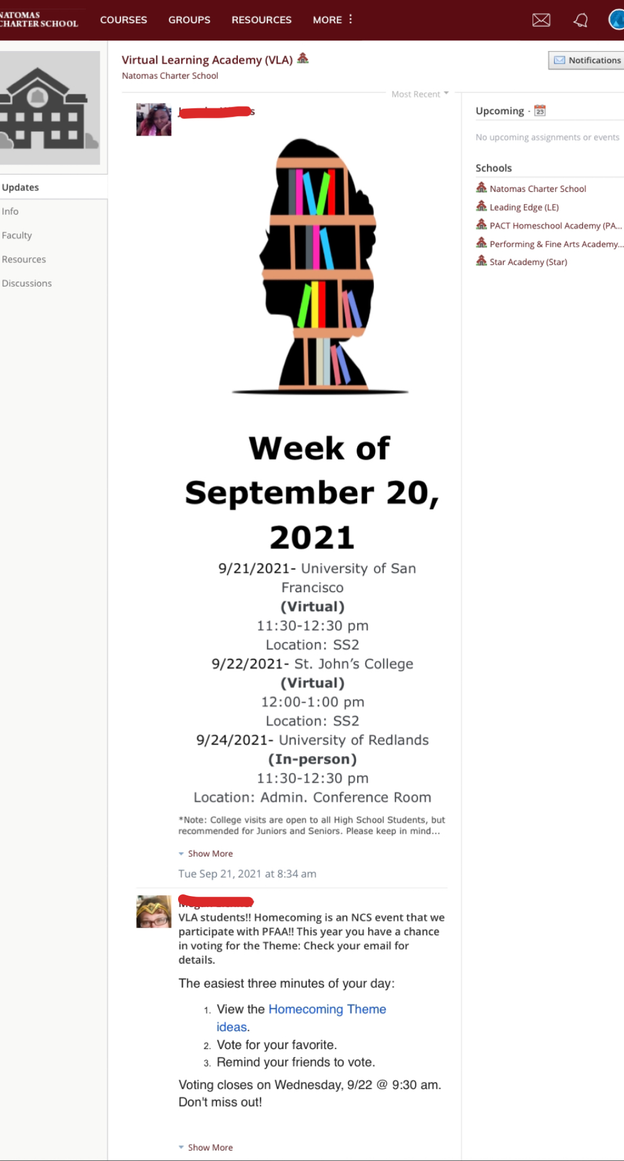
Secondary - aims to reduce the impact
Advertising in Schools beginning at NCS
- creating informational physical and digital documents on where to find help and resources for mental health and healthcare as a whole
-utilizing influence and access as a member of the leadership and link crew program to spread the word and ask others to spread the information
Notes:
Present:Yazmin

Slide 8
Tertiary - aims to soften the impact of an ongoing issue and lasting effects
Healthcare Access For All
People from different backgrounds deserve healthcare access because
Notes:
Present:Alexis

Slide 9
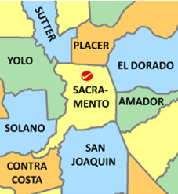
Health Access California
1127 11th St #925 Sacramento, CA 95814
Open ⋅ Closes 5PM · (916) 497-0923
One Community Health
1442 Ethan Way #100 Sacramento, CA 95811
Open 8 AM ⋅ Closes 7PM · (916) 443-3299
California Black Health Network
520 9th St Suite 100, Sacramento, CA 95814
Open 9 AM ⋅ Closes 5 PM · (916) 333-0613
Health Education Council
3950 Industrial Blvd Suite 600, West Sacramento, CA 95691
Open 9 AM ⋅ Closes 3:30 PM · (916) 556-3344
Community Resources
Notes:
Present:Yazmin

Slide 10
Health Access California
An advocacy coalition that creates a voice for Californian’s in need of health access
Their goal is to preserve protect and expand health access by implementing and improving the affordable care act
Notes:
Present:Yazmin

Slide 11
One Community Health
A nonprofit health center catered to folks in the Sacramento area regardless of age, gender, ethnicity, orientation, or ability to pay.
Their goal is to increase healthcare access in their community
Notes:
Present: Mario

Slide 12
California Black Health Network
“CBHN conducts outreach, education, and advocacy to achieve health equity for Black Californians through the lens of understanding critical issues that lie at the intersection of racial justice, social justice, and environmental justice.”
Notes:
Present: Yazmin

Slide 13
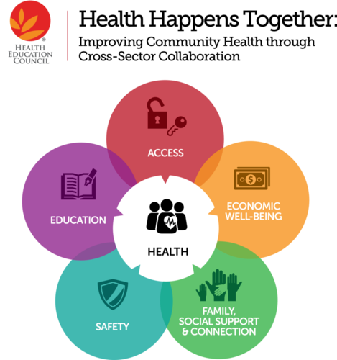
Health Education Council
The mission of the Health Education Council is: “to cultivate health and well-being in underserved communities by leveraging the power of collaboration”
Notes:
Present:Alexis

Slide 14
Statistics
Notes:
Present:Yazmin
https://docs.google.com/forms/d/1tQf0mSIj5NB0qWBcIVfwoSDMIrt1XwaS3Ly71njD7D0/edit

Slide 15
What people are saying
“The price can be a bit much for individuals, which can make them restrain themselves from getting the help that their hoping for.”
“There are many options to receive mental health help but they cost a lot so healthcare does affect if one gets help or not.”
“I feel like a majority of the time having medication prescribed for anxiety or things like ADHD are not available to people who don’t have healthcare” ….” I feel like more access to health care would help solve this problem of people living their lives untreated.”
Notes:
Present:Yazmin

Slide 16
References
Robert H. Shmerling, M. D. (2021, July 13). Is our healthcare system broken? Harvard Health. Retrieved September 21, 2021, from https://www.health.harvard.edu/blog/is-our-healthcare-system-broken-202107132542.
https://docs.google.com/forms/d/1tQf0mSIj5NB0qWBcIVfwoSDMIrt1XwaS3Ly71njD7D0/edit
Williams DR, Cooper LA. Reducing Racial Inequities in Health: Using What We Already Know to Take Action. Int J Environ Res Public Health. 2019 Feb 19;16(4):606. doi: 10.3390/ijerph16040606. PMID: 30791452; PMCID: PMC6406315.

